Slide 1
MODEL Based Threat & Risk Assessment
TRADES TOOL

Slide 2


TRADES
TRADES – a field-proven Threat and Risk Assessment Methodology
Cybersecurity as a leading design perspective
Based on research of model-driven engineering conducted at Tel Aviv University (TAU-SERI)
TRADES Tool – a tool supporting the implementation of the methodology
Based on open-source infrastructure (Eclipse Modeling Framework)
Easy to use
Easy to extend and tailor

Slide 3
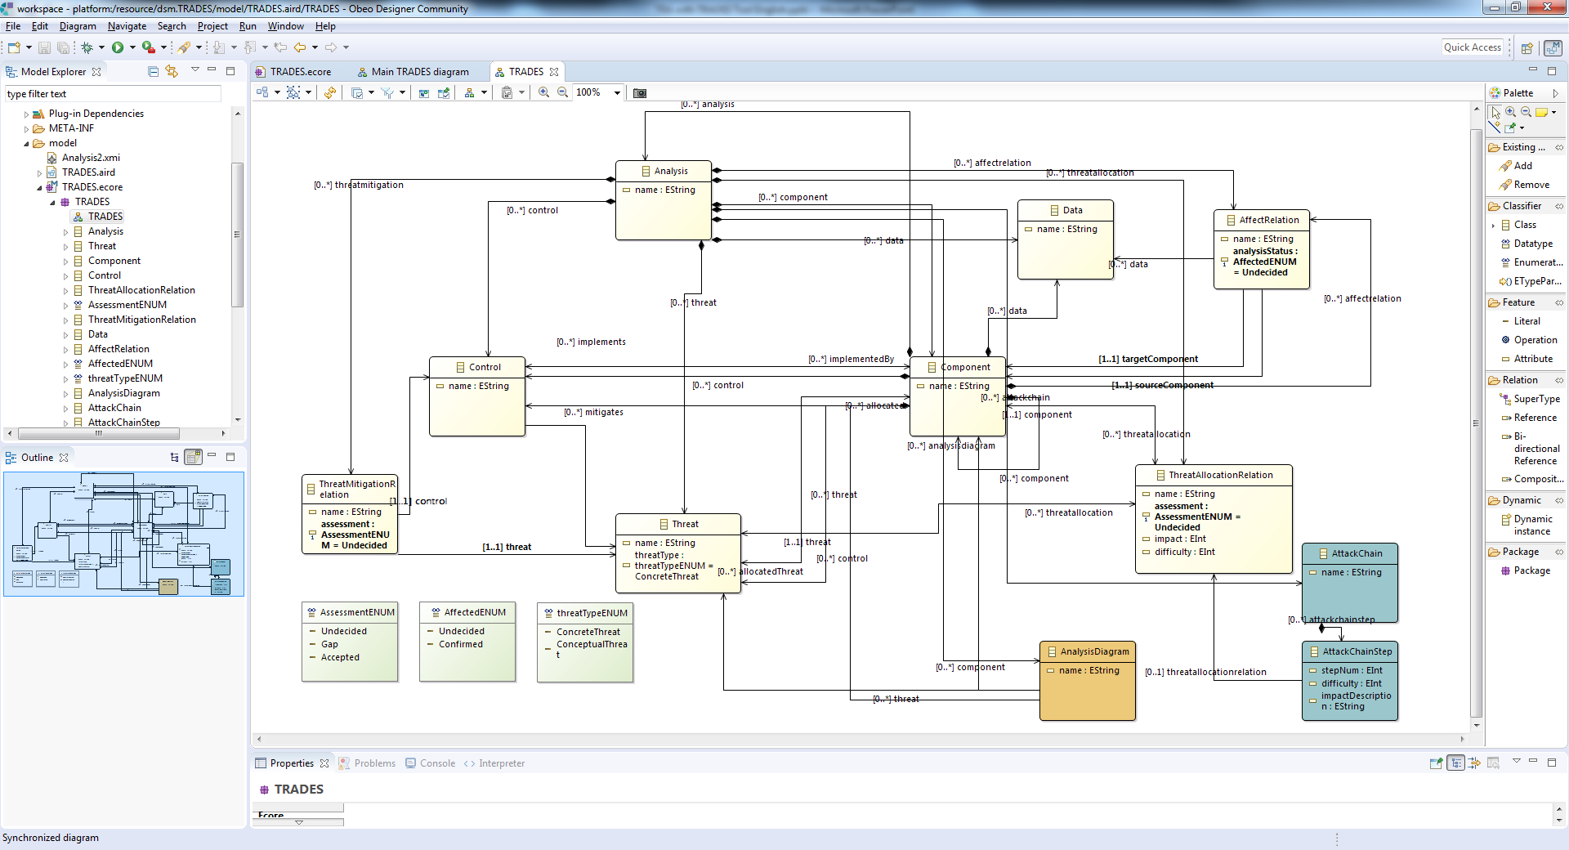
ECORE Metamodel

Slide 4
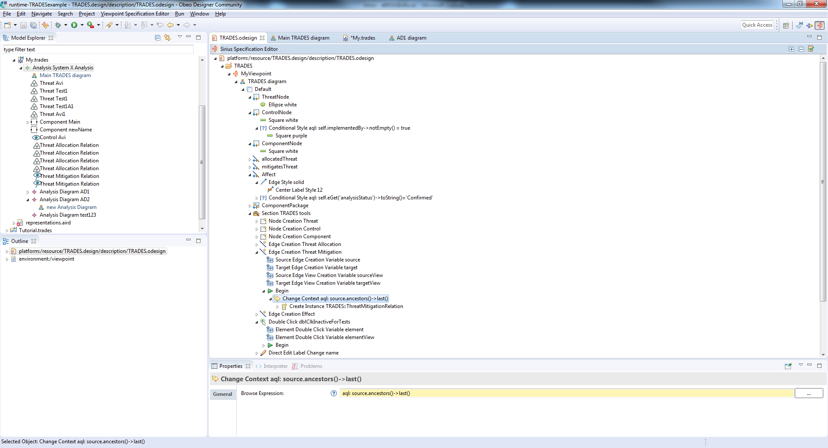
SIRIUS design

Slide 5
Demonstration
System cybersecurity analysis using TRADES Tool

Slide 6

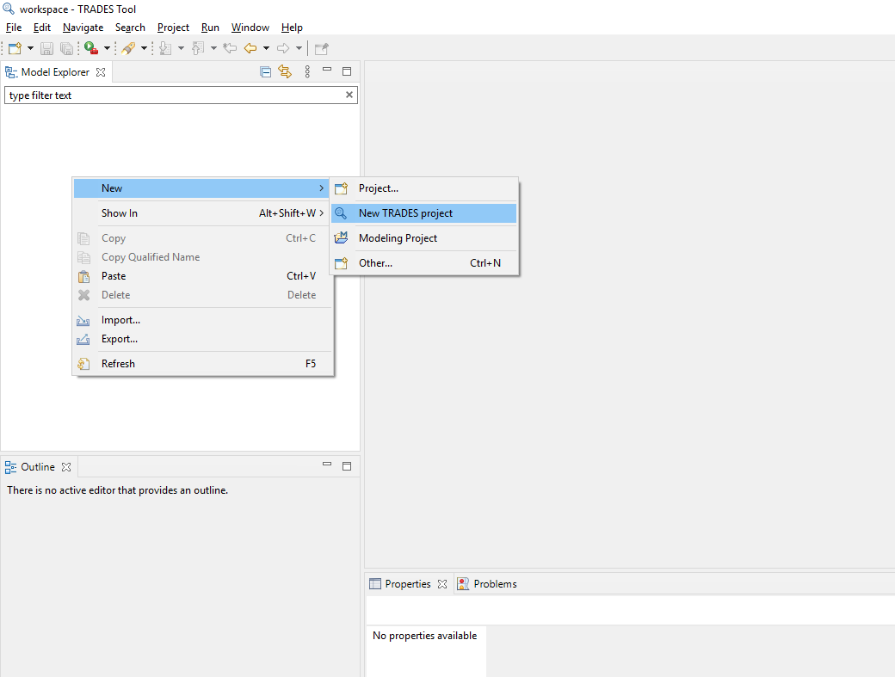
Create new TRADES project

Slide 7
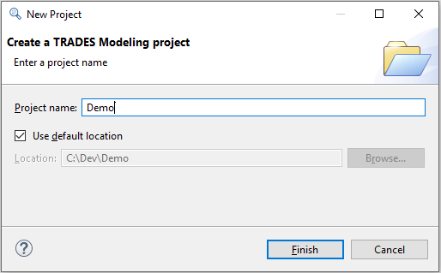
Choose name and click Finish

Slide 8
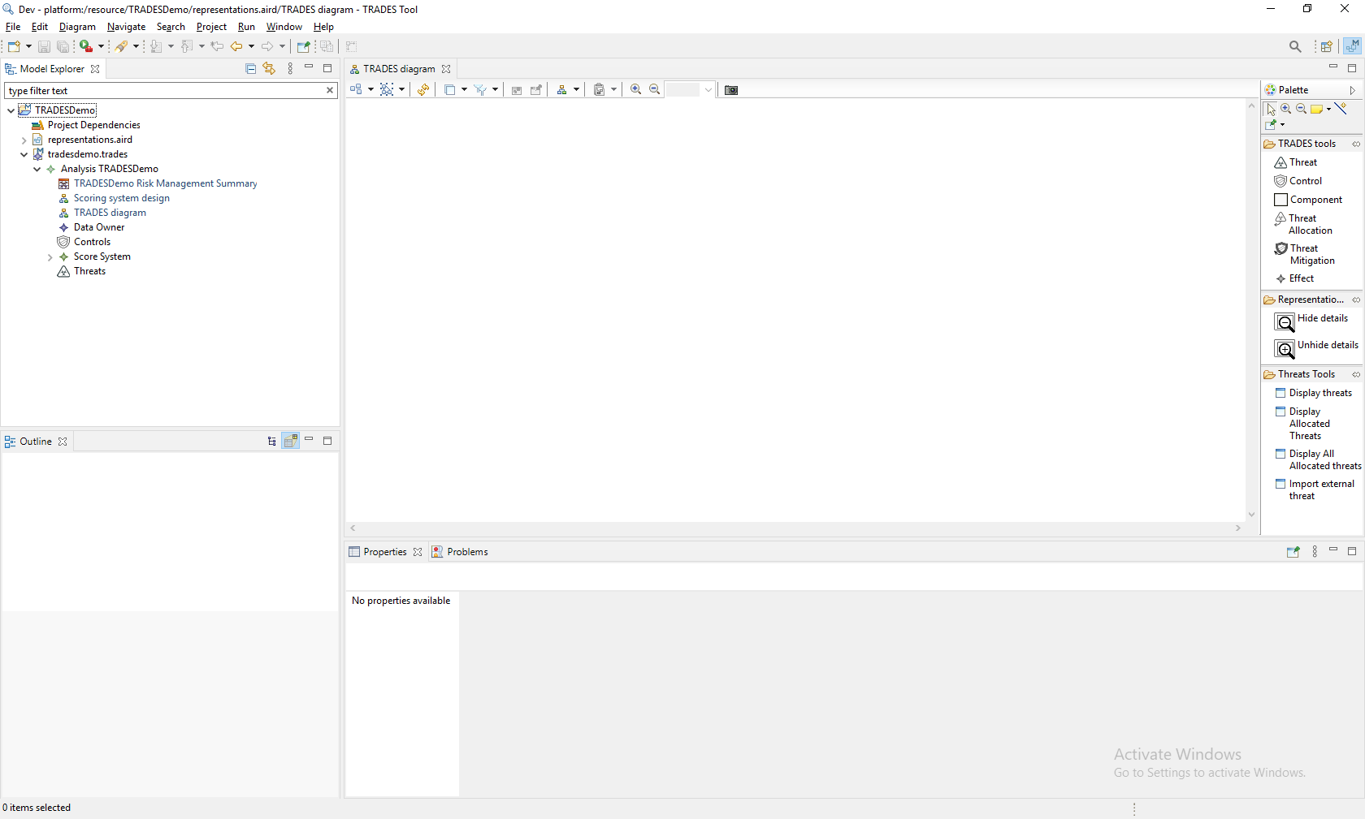
Navigation tree
Graphical modeling area
Modeling toolbox
Model element properties

Slide 9
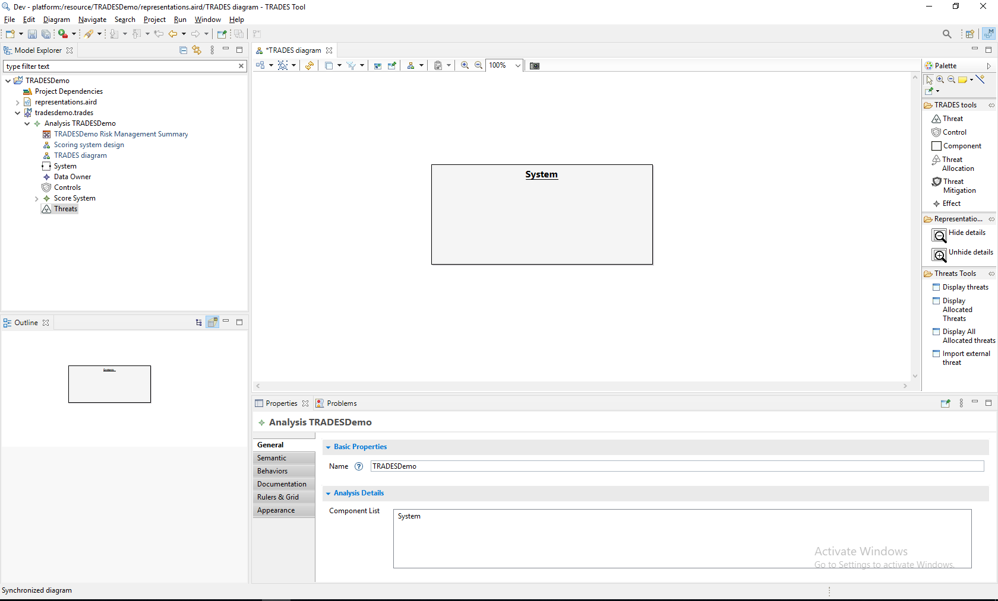
In a TRADES Diagram, use “component” to add a new physical/logical system component

Slide 10
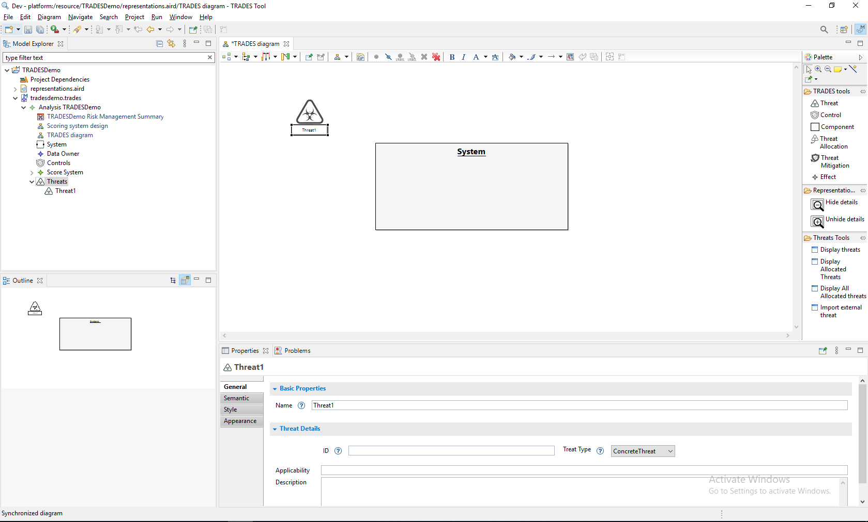
New Threat
Use “Threat” to add a new threat

Slide 11
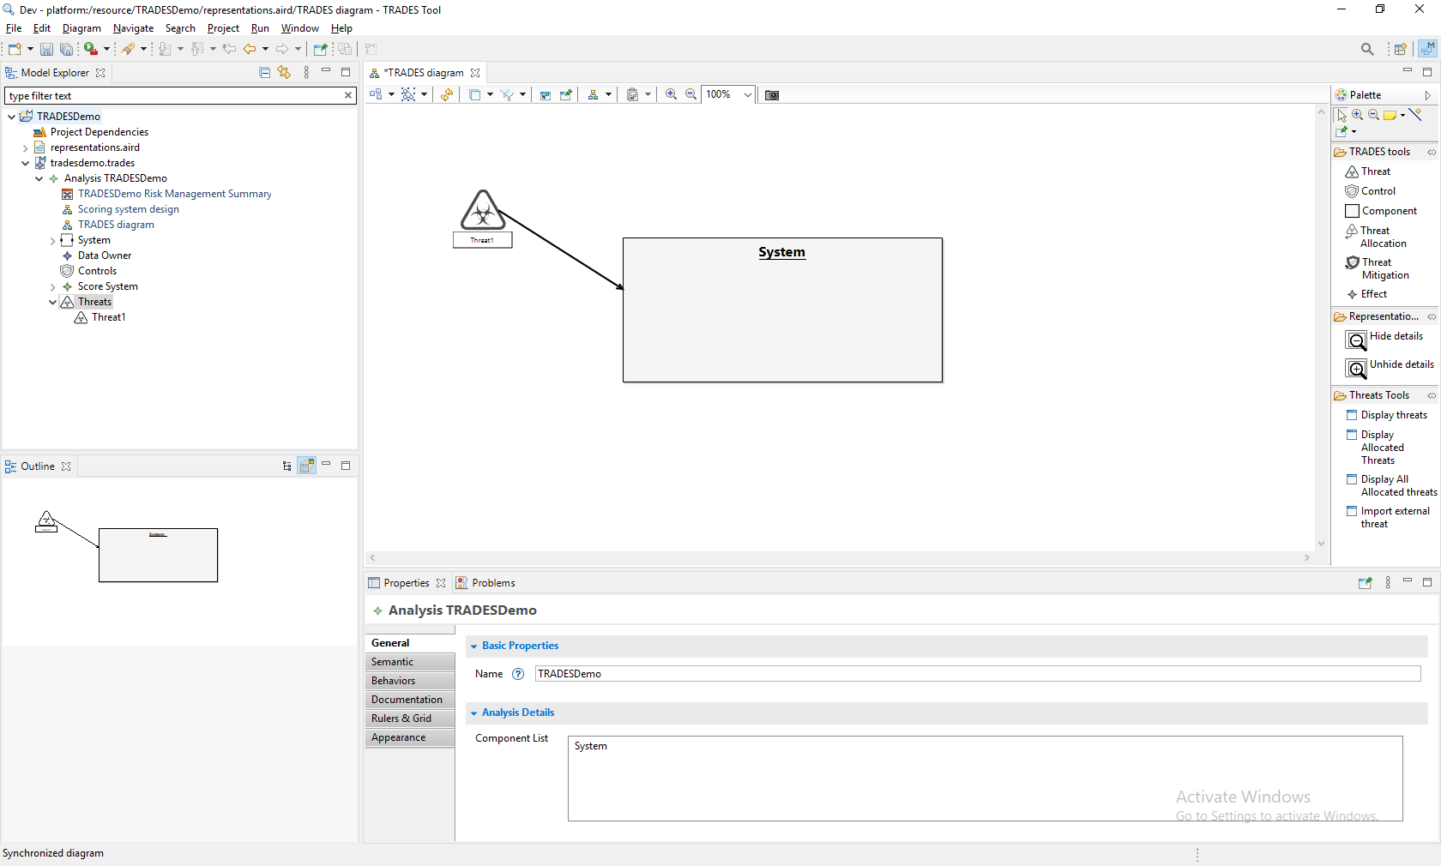
New Allocation
Use “Threat Allocation” to allocate a threat to a component

Slide 12
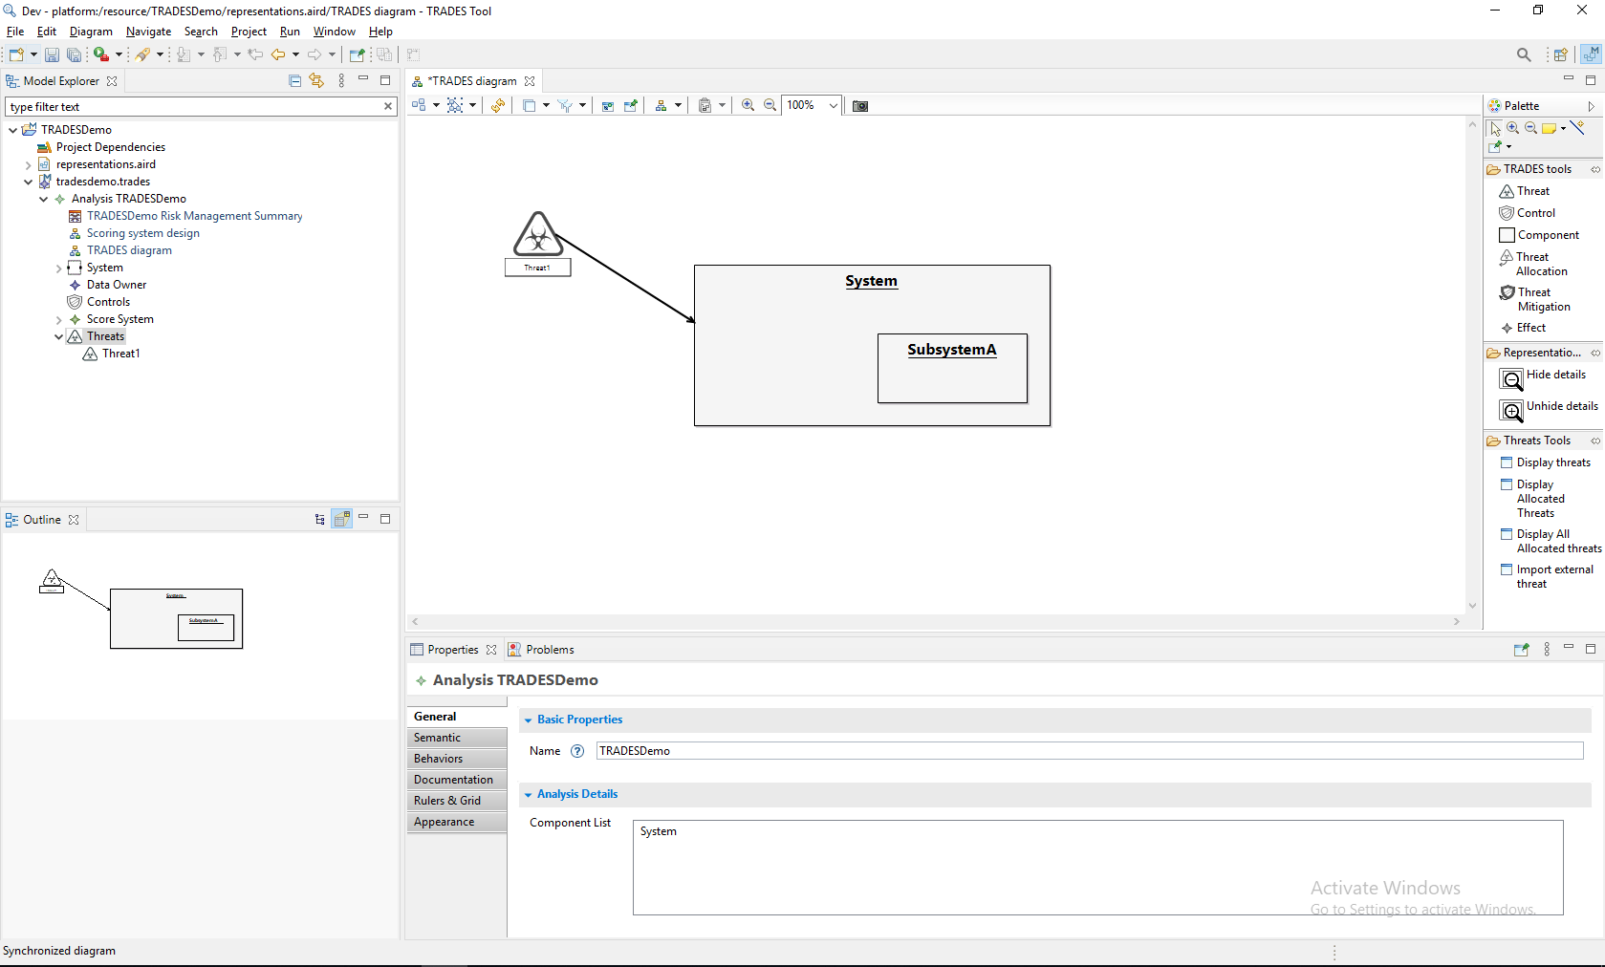
Create an additional component for a subsystem by applying “Component” tool within the “System” element

Slide 13
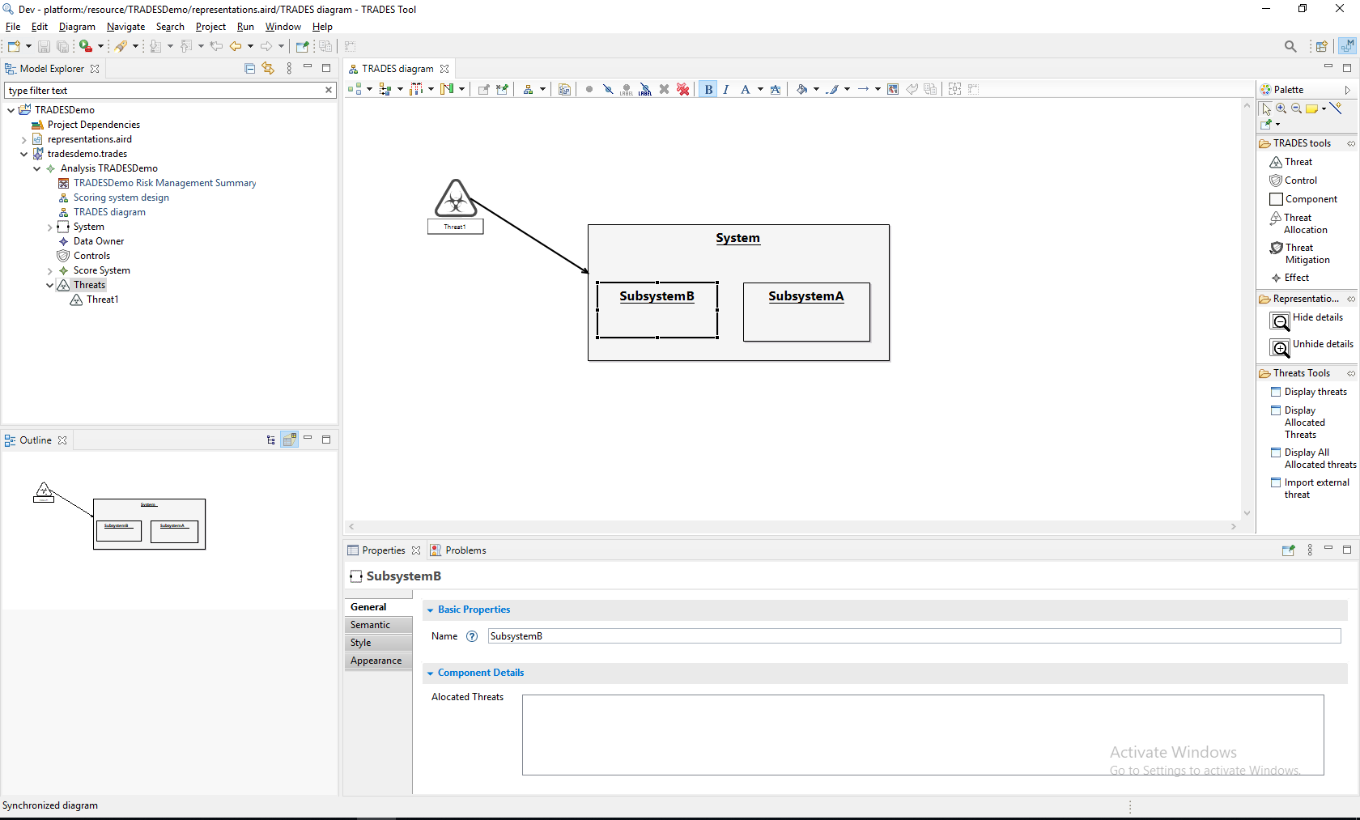
and another subsystem…

Slide 14
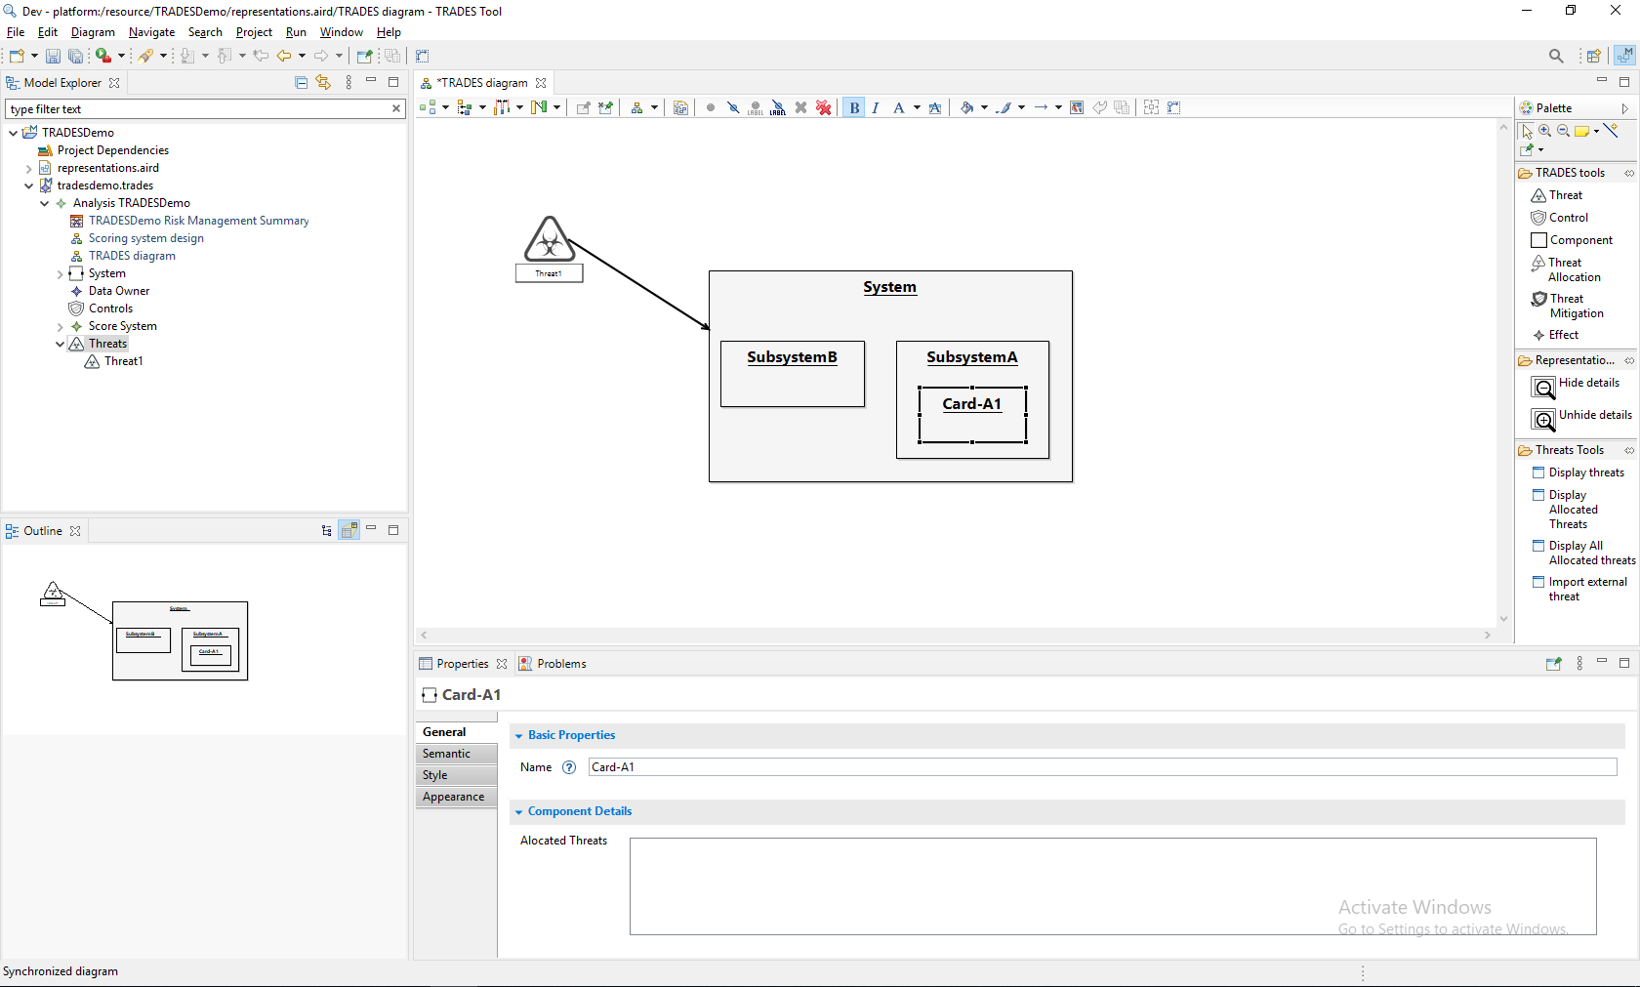
create a lower hierarchy component by applying “Component” within “SubsystemA”

Slide 15
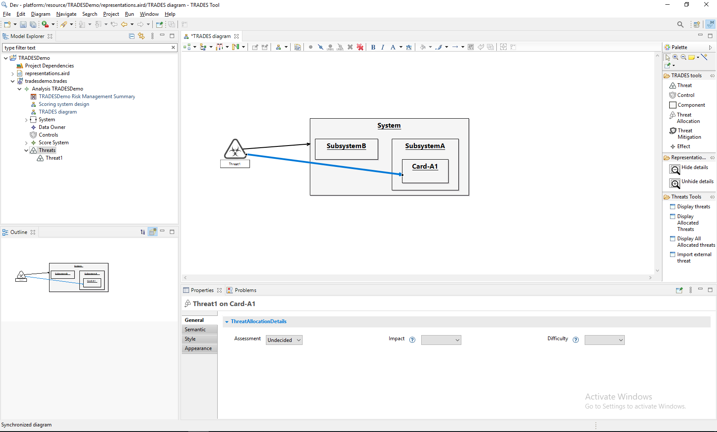
Allocate the threat to a subsystem

Slide 16
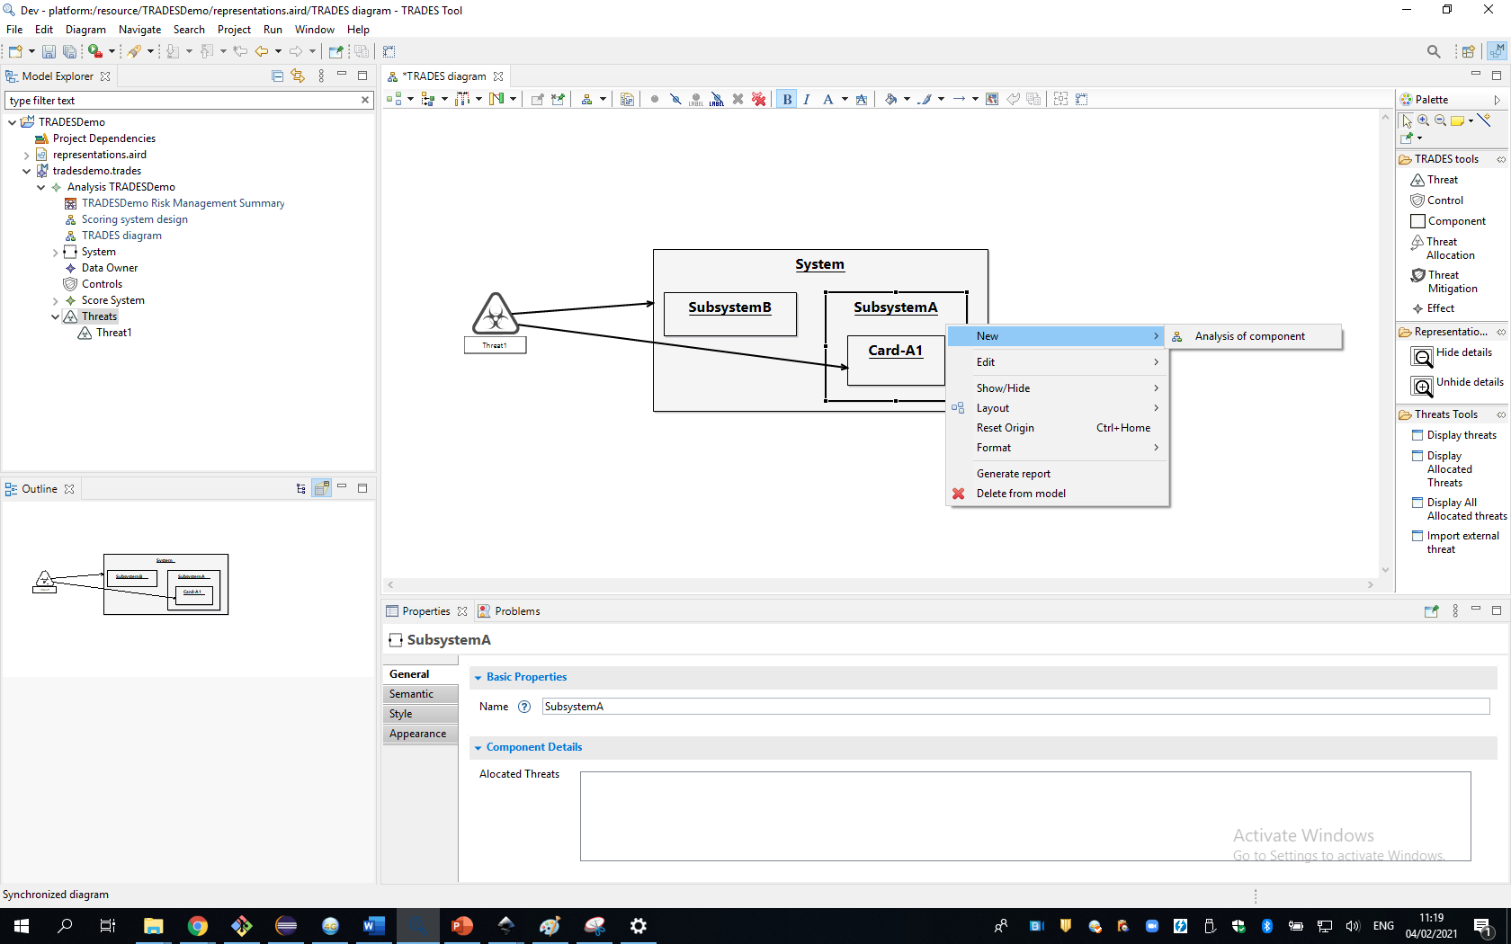
Open a new perspective for a dedicated analysis of the subsystem

Slide 17
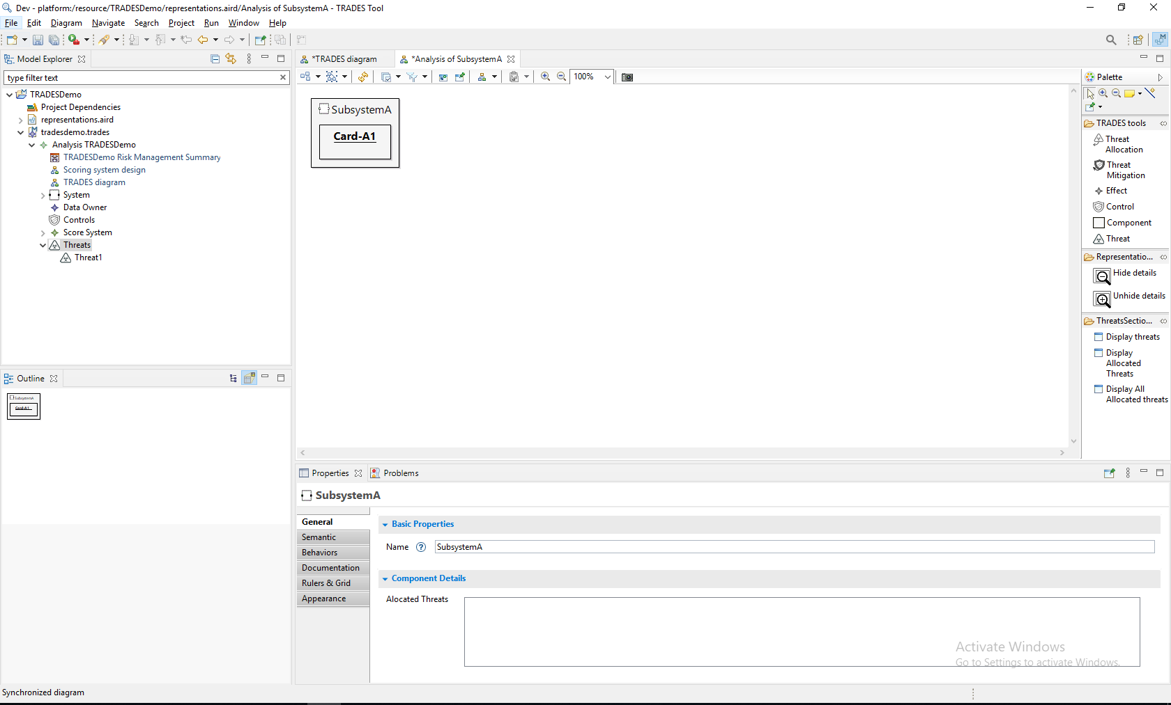
The newly created perspective is automatically synced with existing model elements

Slide 18
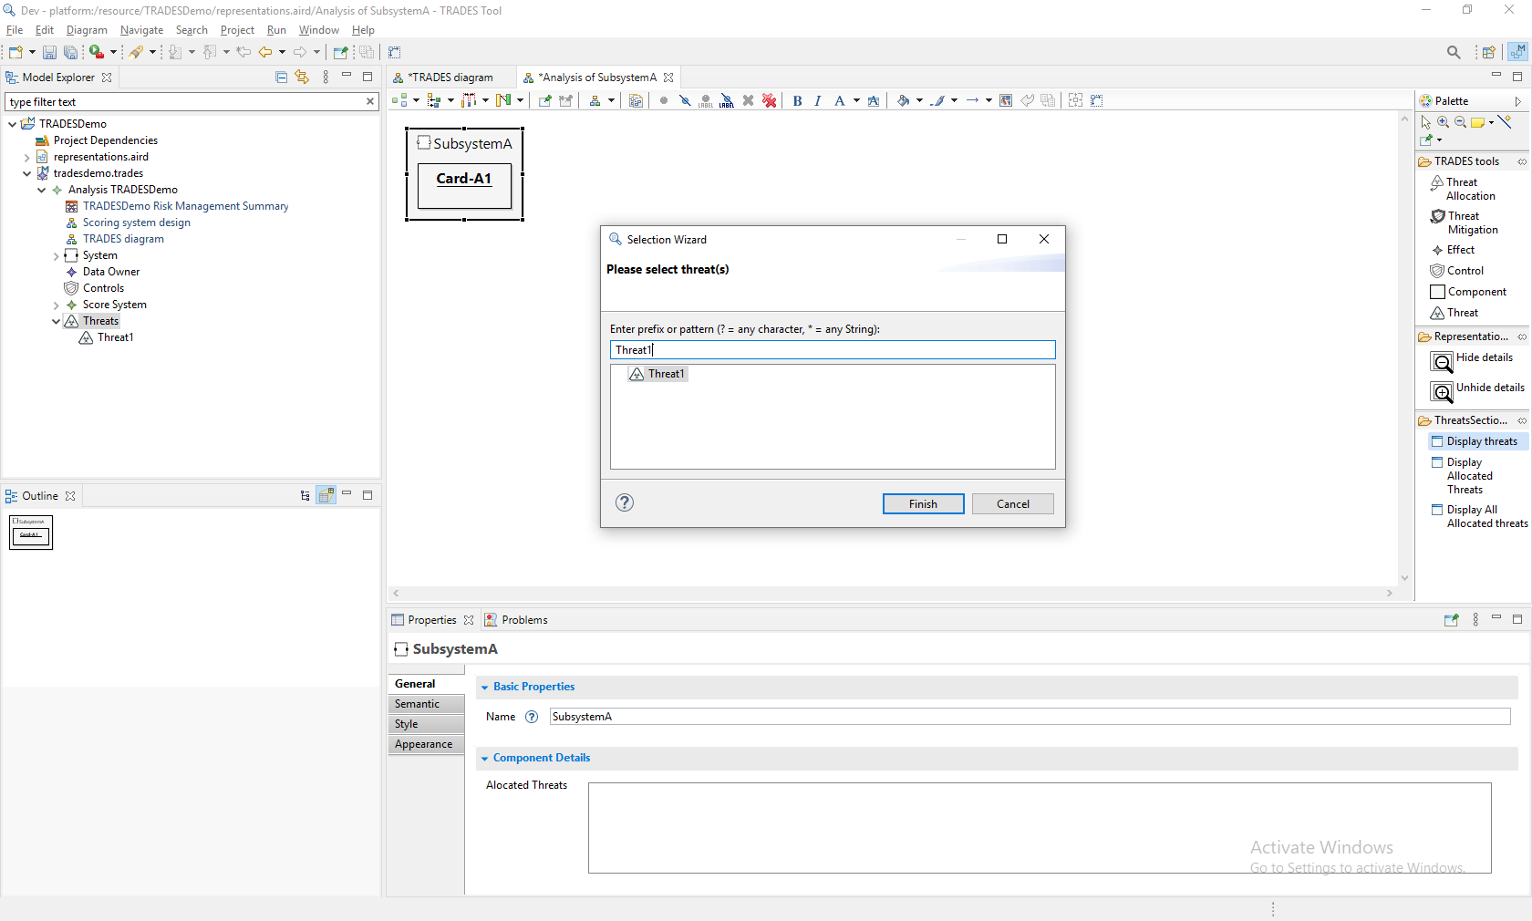
Use the tool to add the existing threats

Slide 19

Threat displayed

Slide 20
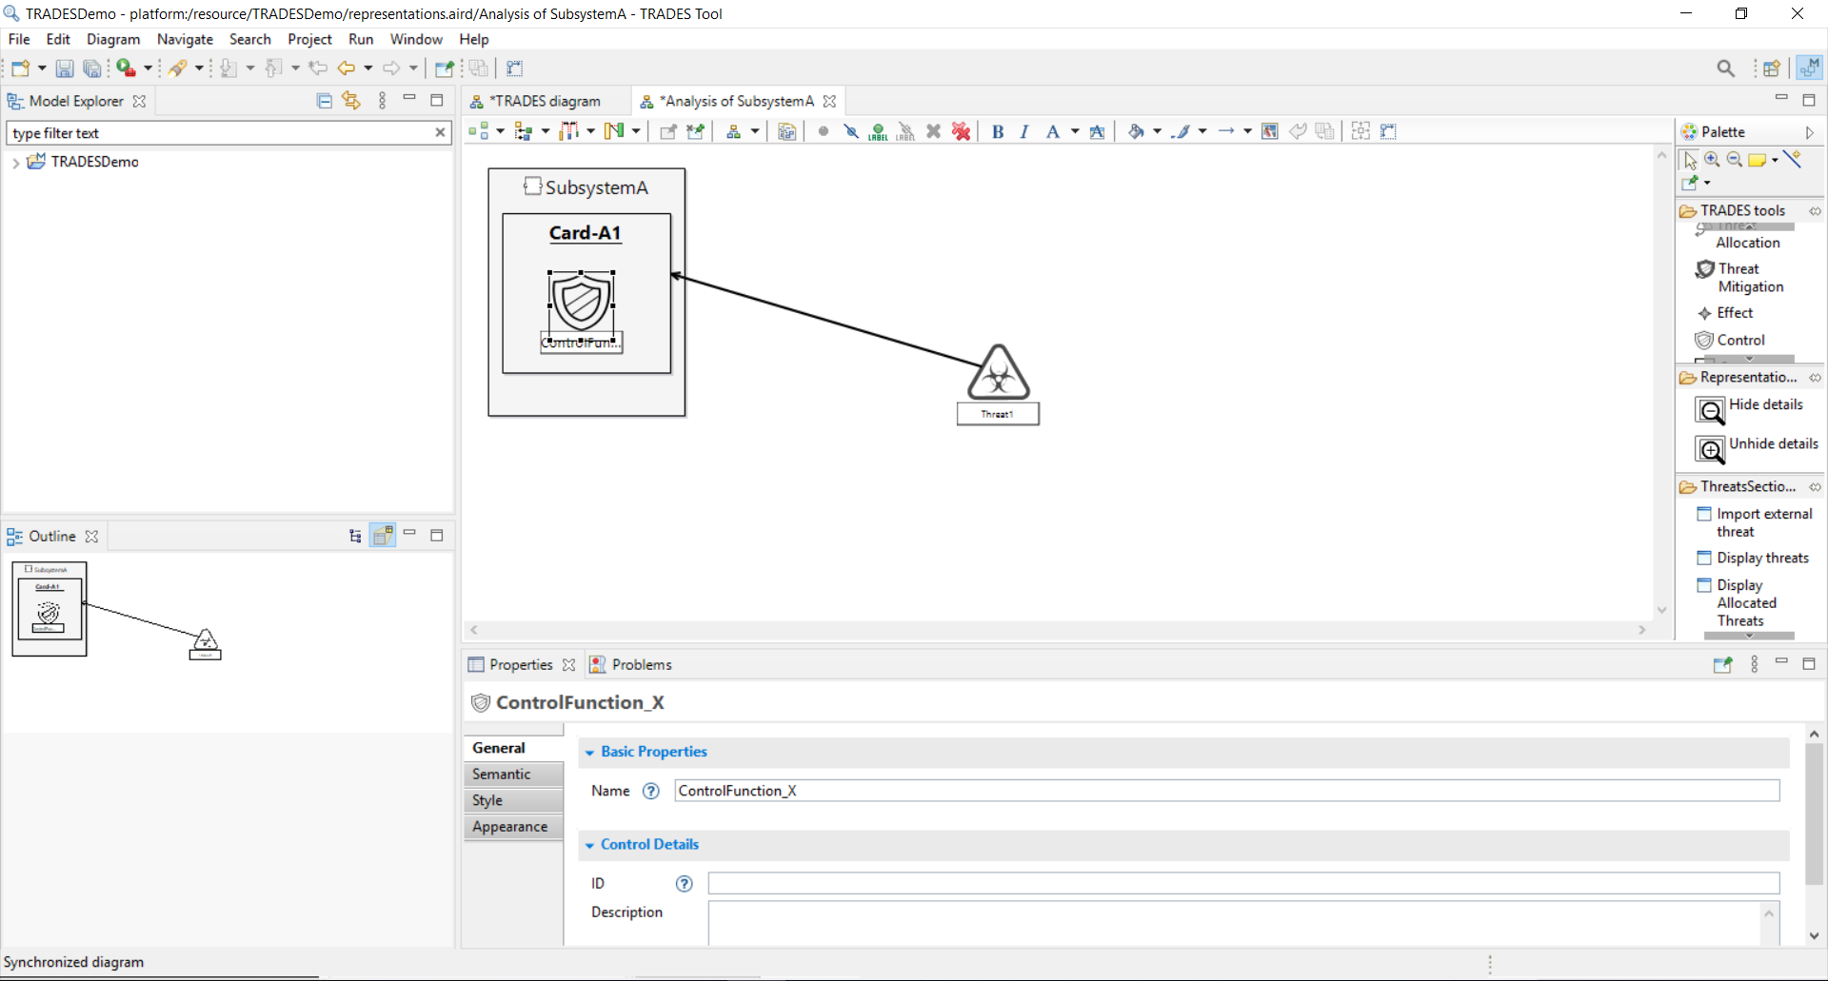
Add a security control using “Control”

Slide 21
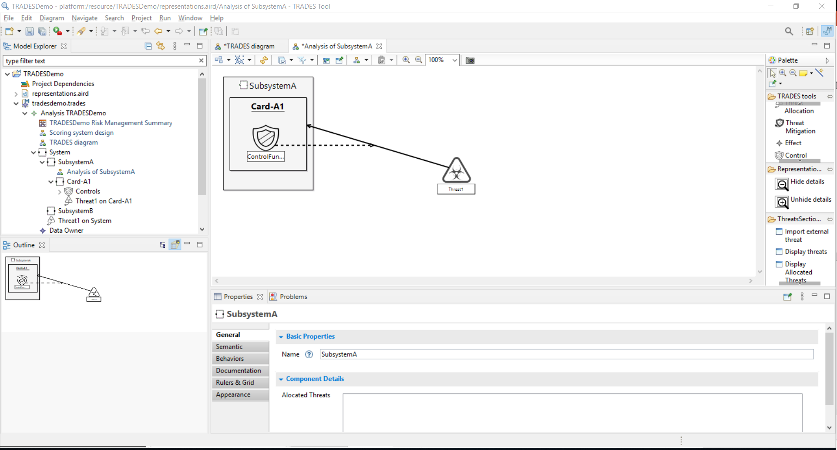
New Mitigation
Associate the control with a threat allocation using “Threat Mitigation”, to indicate that the control mitigates the threat allocation

Slide 22
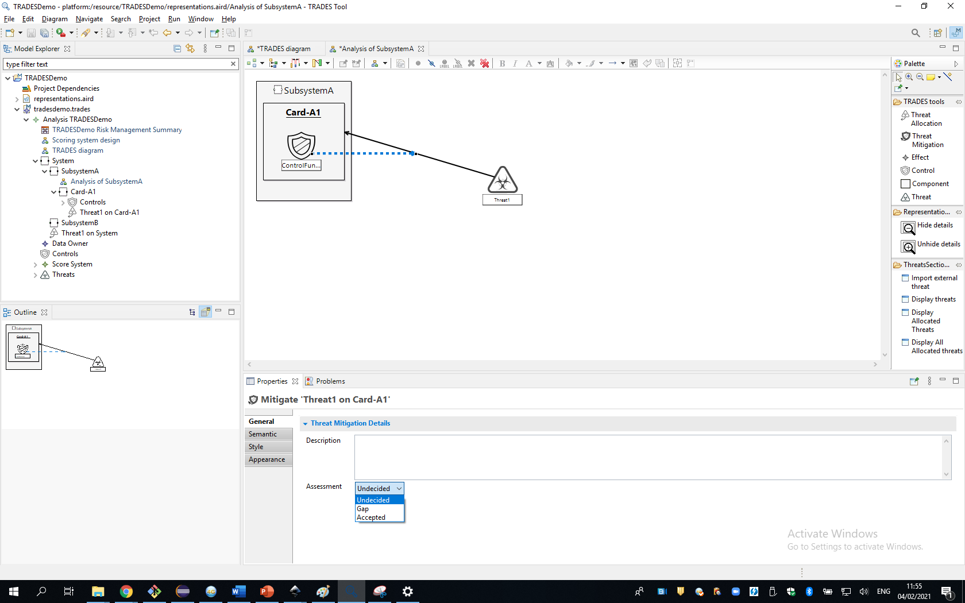
Assess if the threat mitigation is relevant

Slide 23
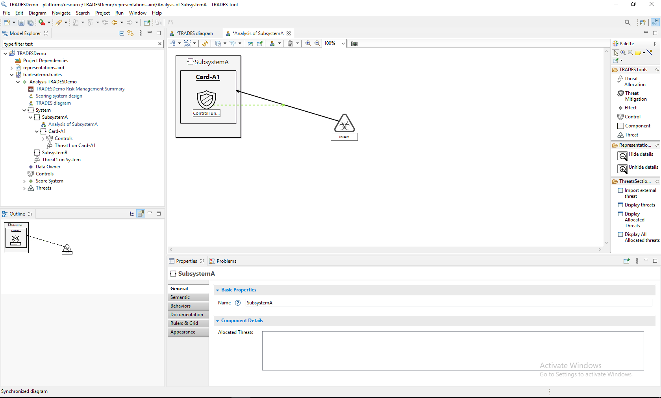
Link color changes according to decision

Slide 24
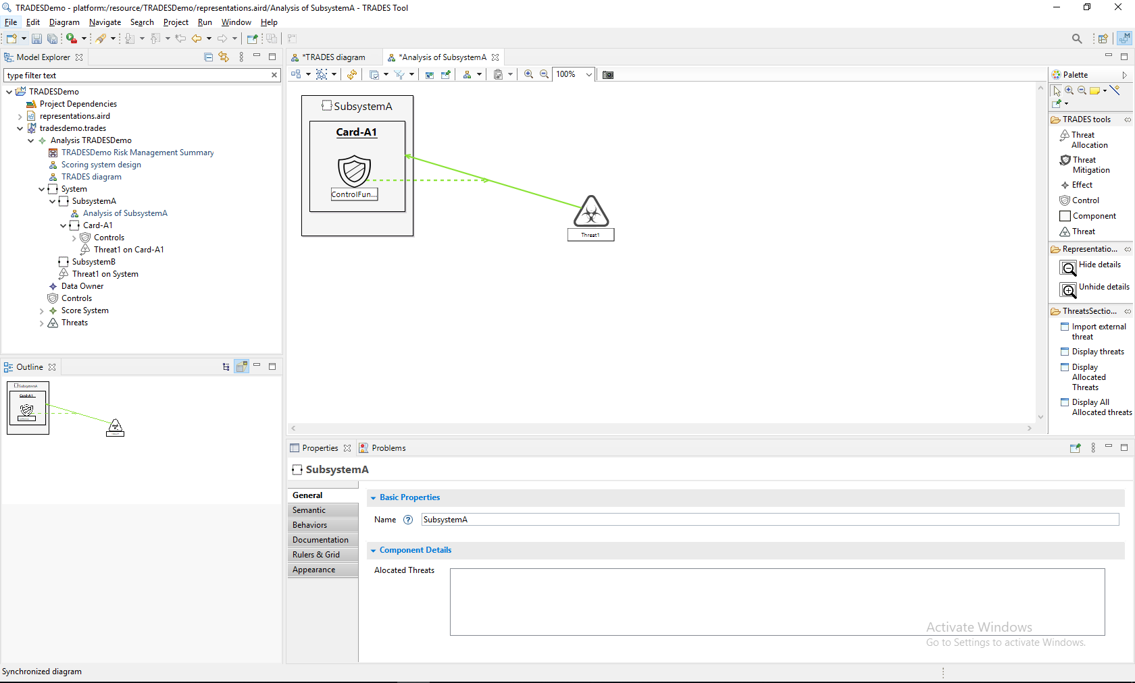
Threat allocation can now be similarly assessed (a technical/managerial decision) and reflected in the diagram

Slide 25
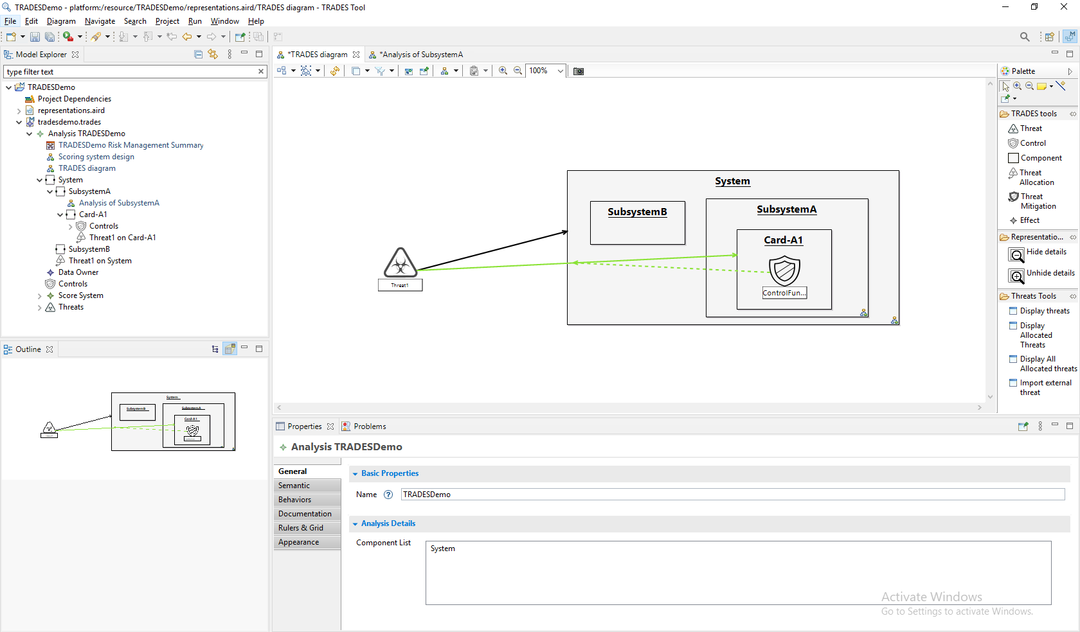
Main diagram is automatically synchronized with added elements and decisions

Slide 26
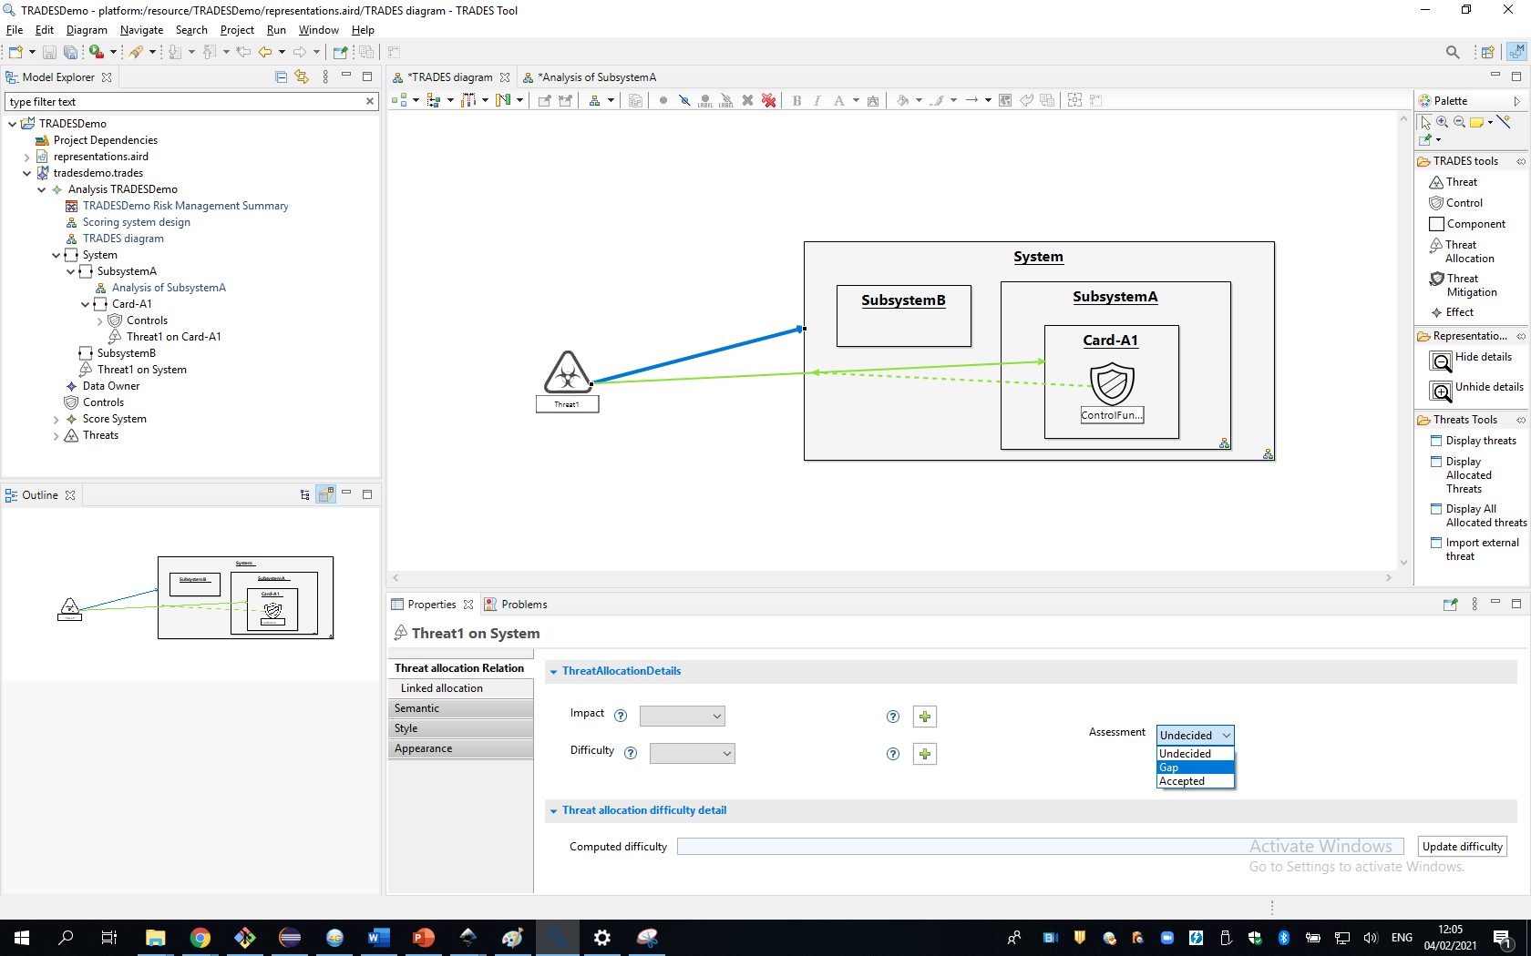
Threat allocation can be marked as a gap

Slide 27
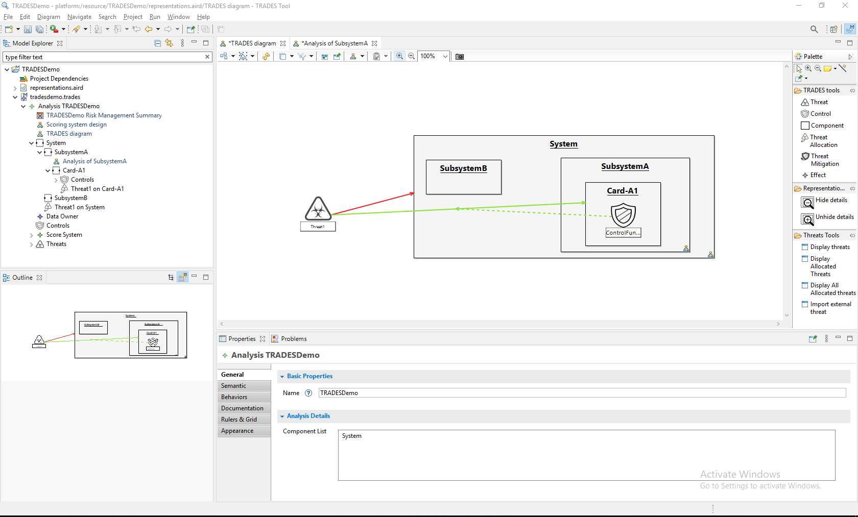
Threat allocation color is updated accordingly

Slide 28
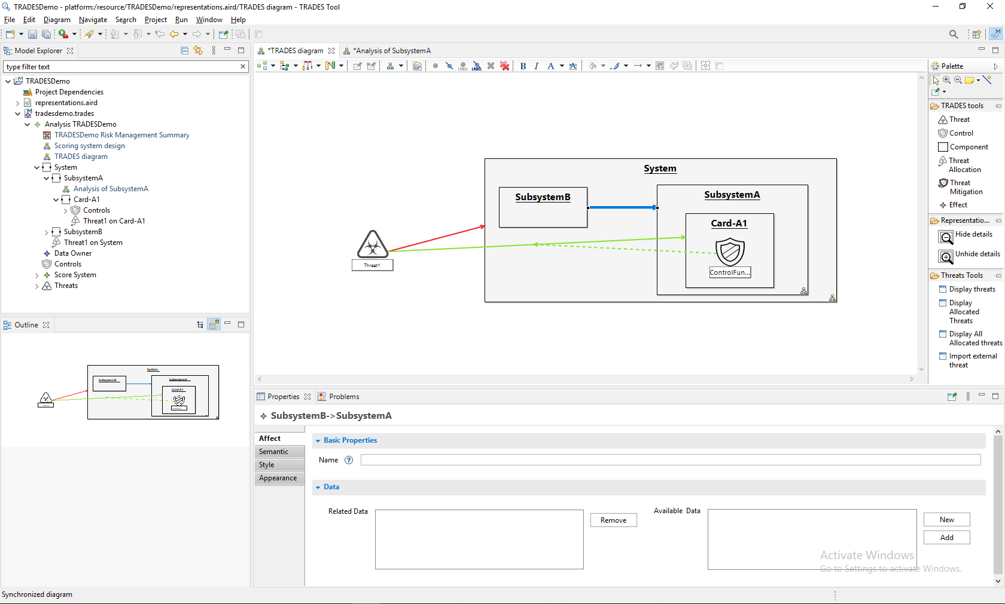
New effect
Data flow within the system can be added by using “Effect” between components

Slide 29
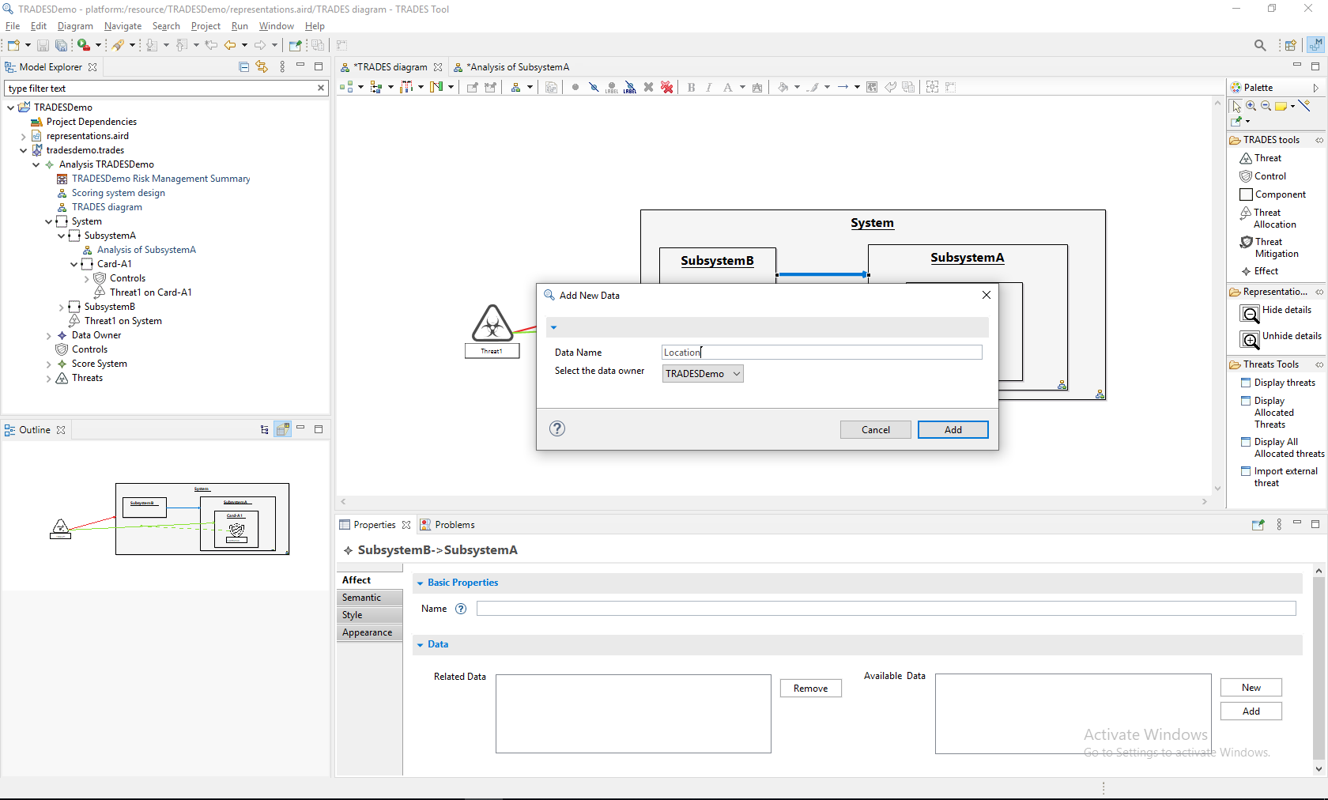
New data can be created

Slide 30
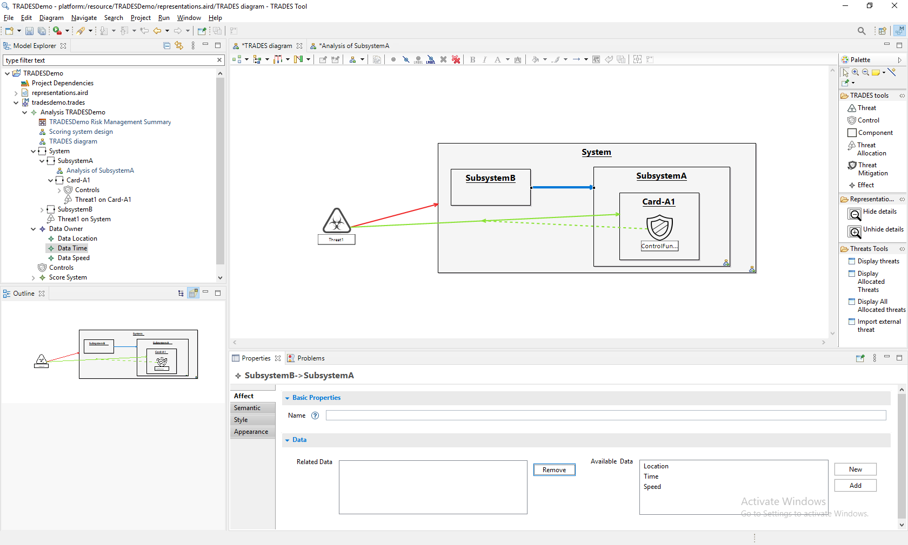
Existing or new data elements can be associated with the flow

Slide 31
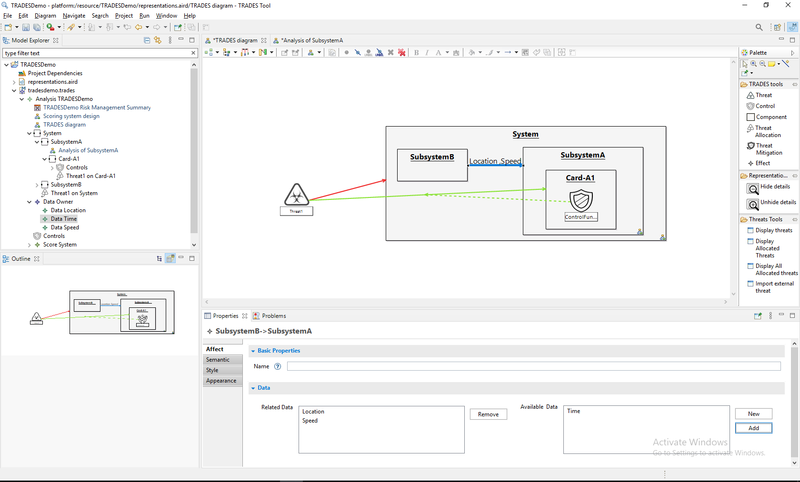
Data associated to the effect
Data associated to the effect

Slide 32
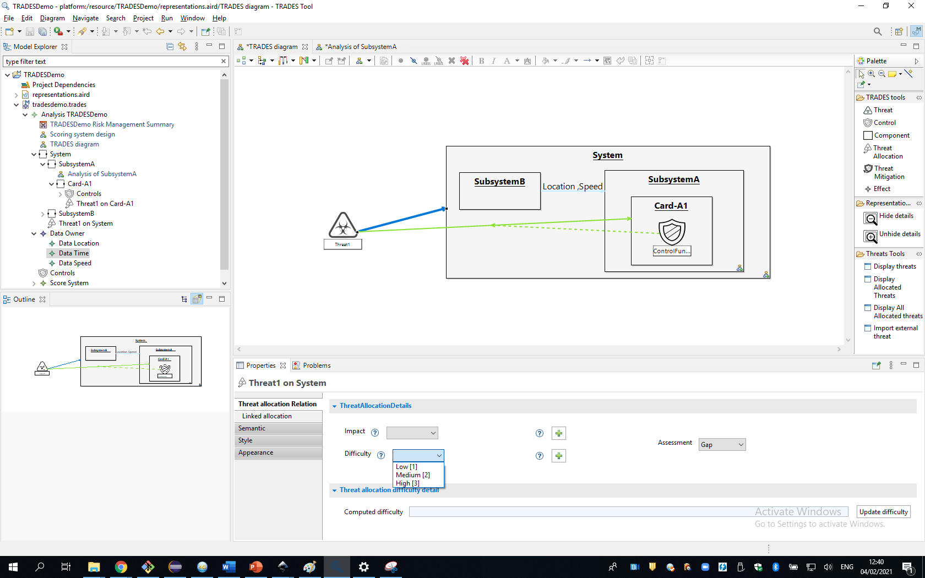
Threat allocations can be rated with difficulty and impact scores
The scale is configurable

Slide 33
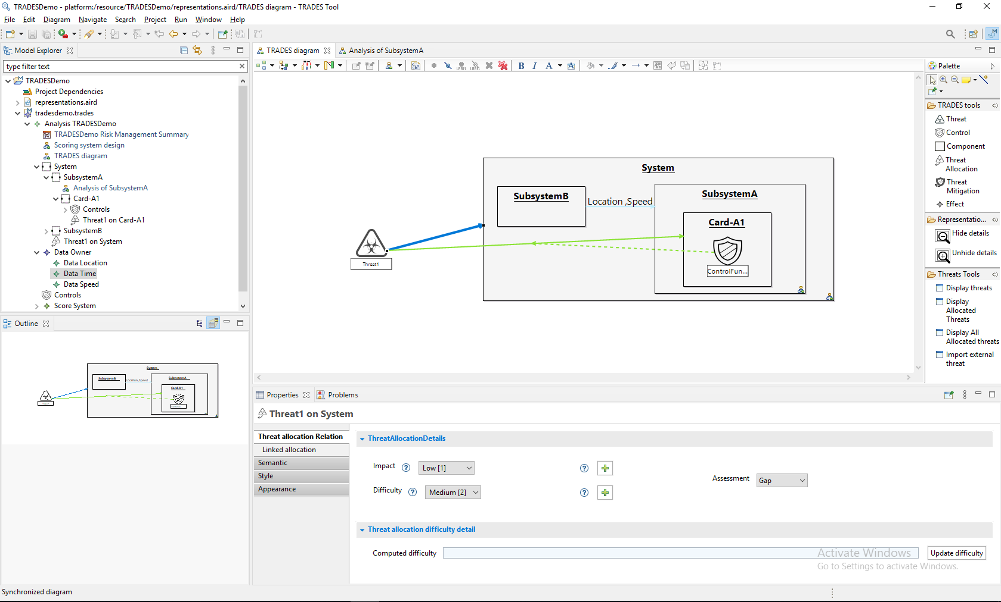
Open the risk management summary representation to view the risk assessment matrix

Slide 34
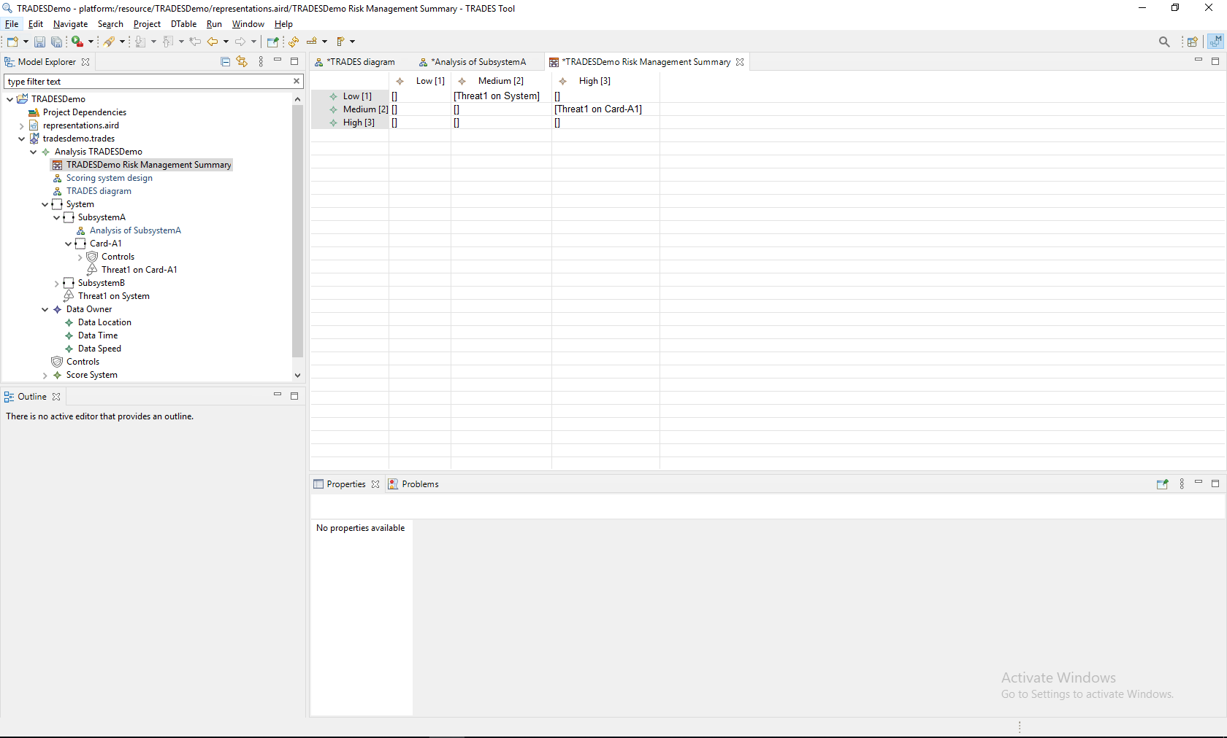
As always, the model-based design of TRADES Tool assures this representation is automatically updated with every change in risk assessment

Slide 35
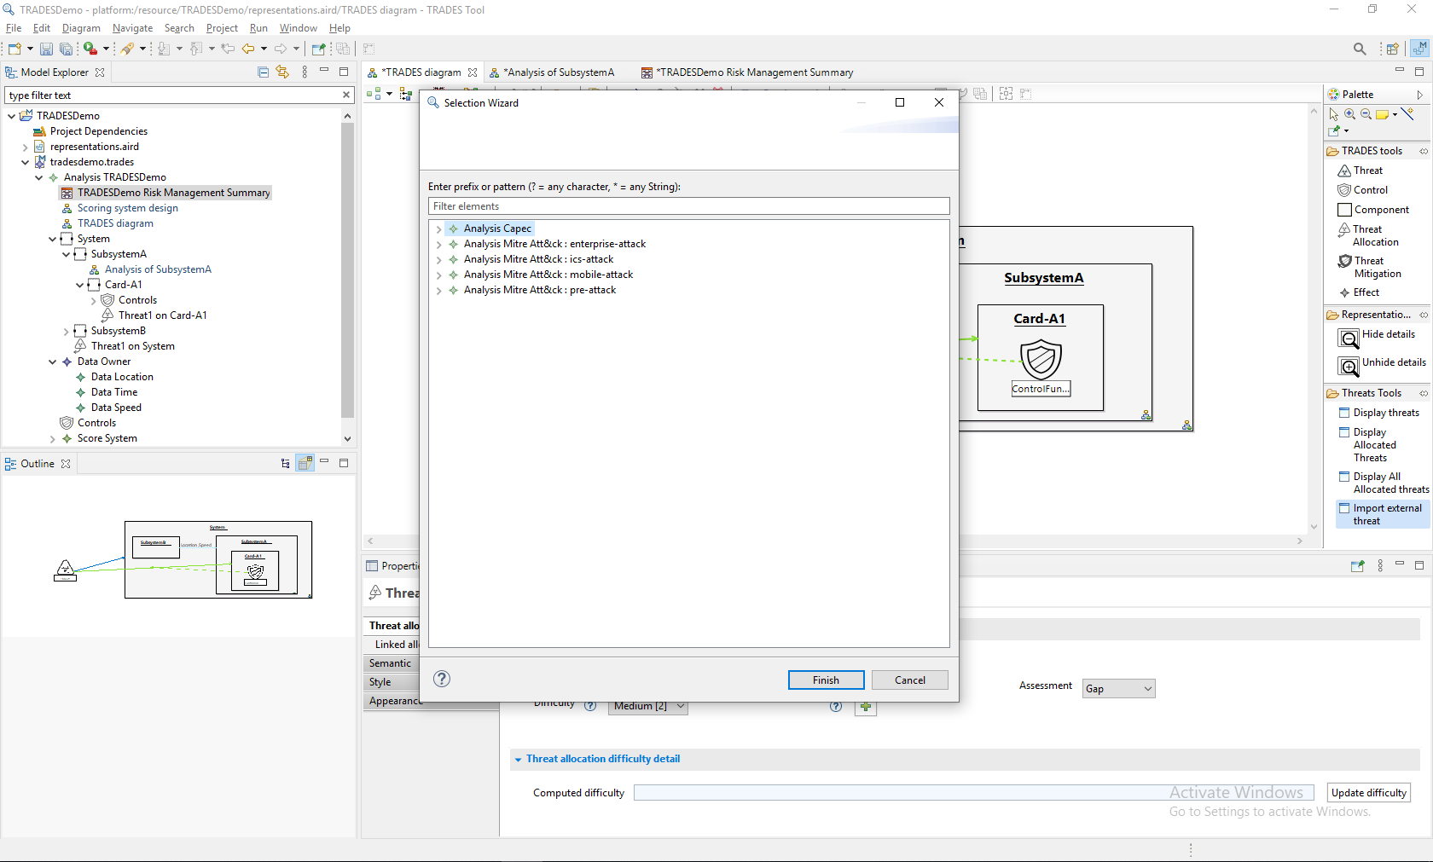
This tool opens the att&ck threats Database

Slide 36
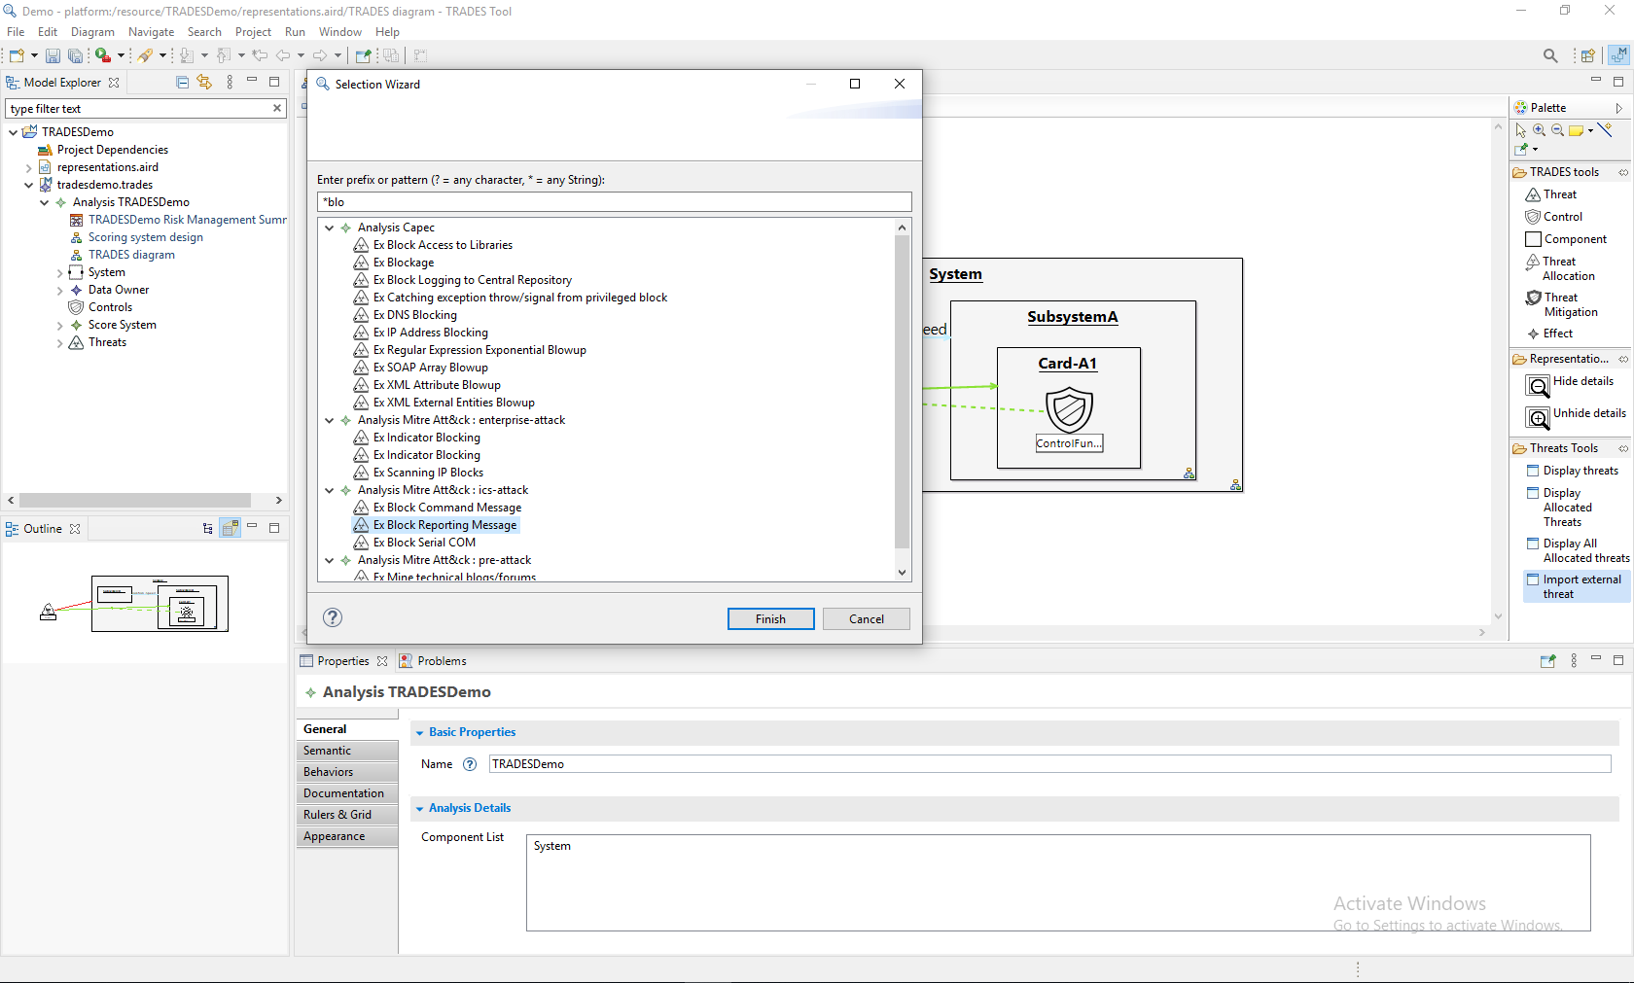
Search option helps to find the relevant threats

Slide 37
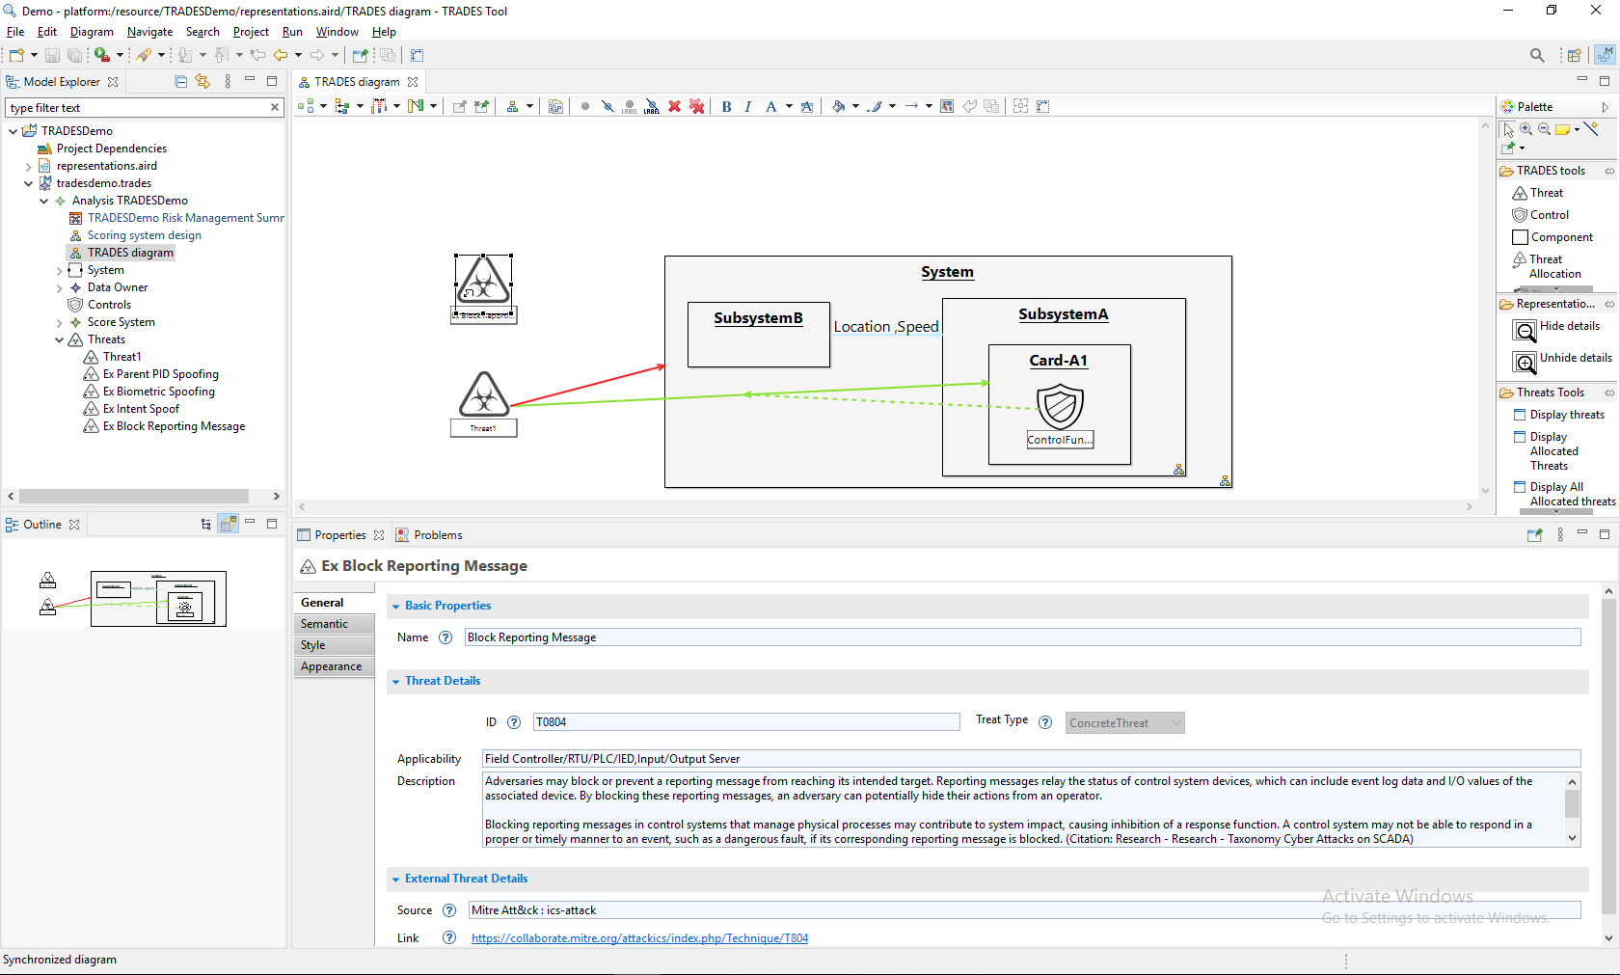
The threat was added
It is part of the model
All the relevant data is here

Slide 38
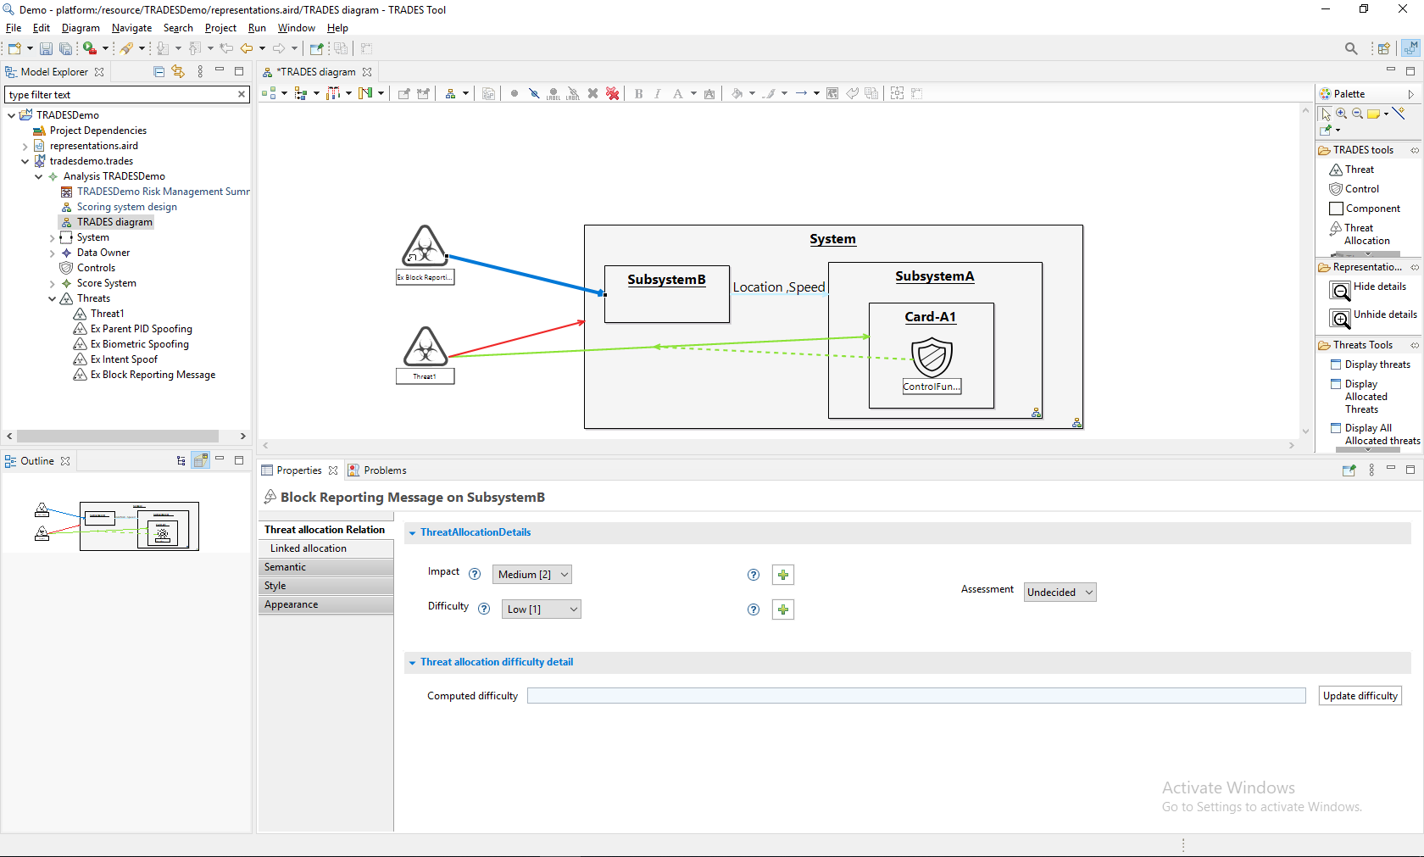
The threat can be allocated

Slide 39
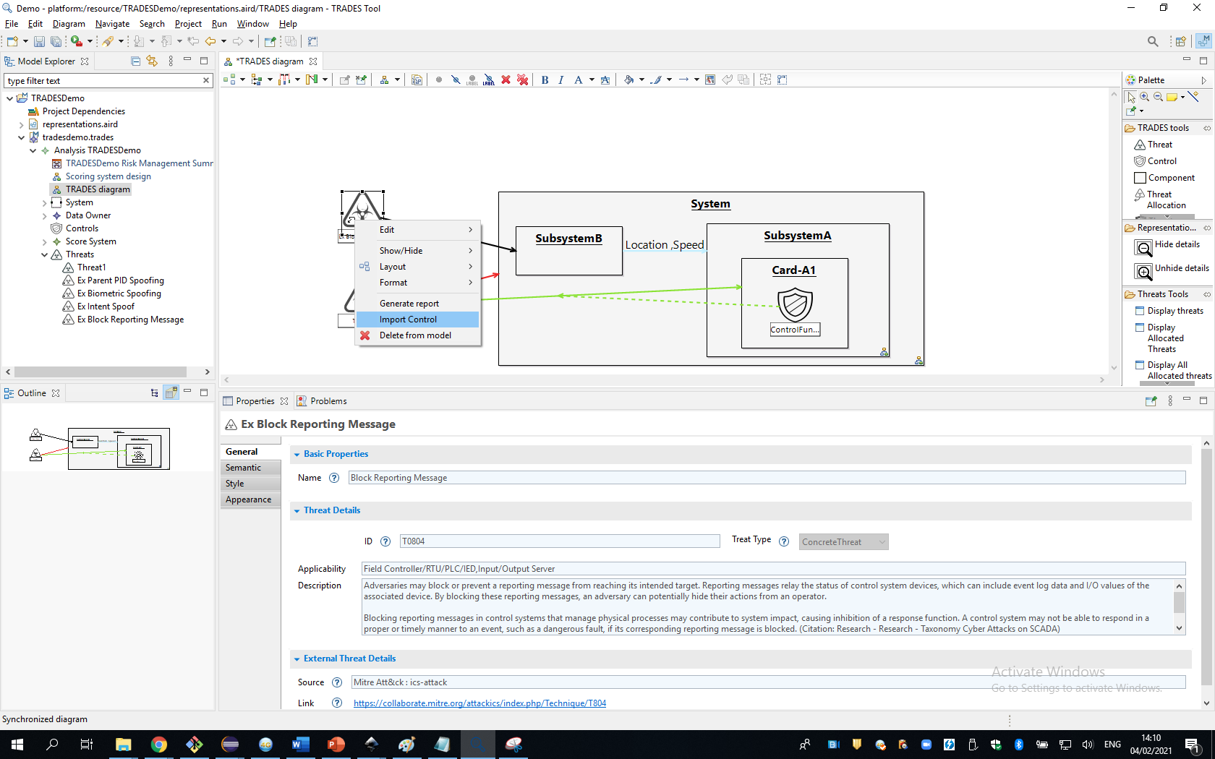
Related controls can be imported

Slide 40
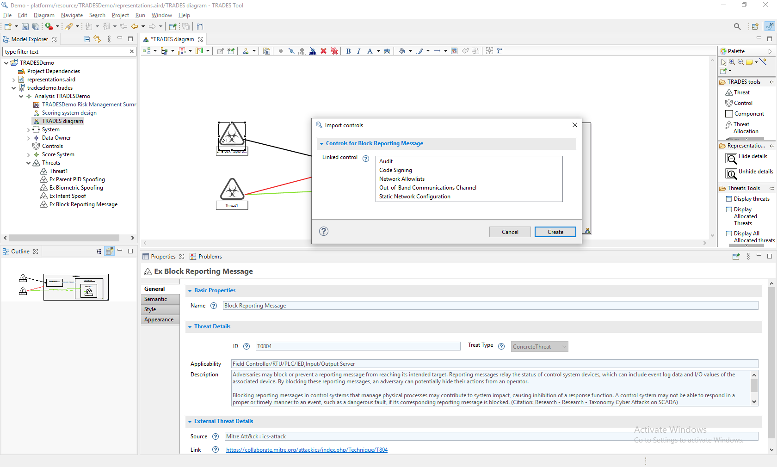
Choose the relevant controls to your implamantaion

Slide 41
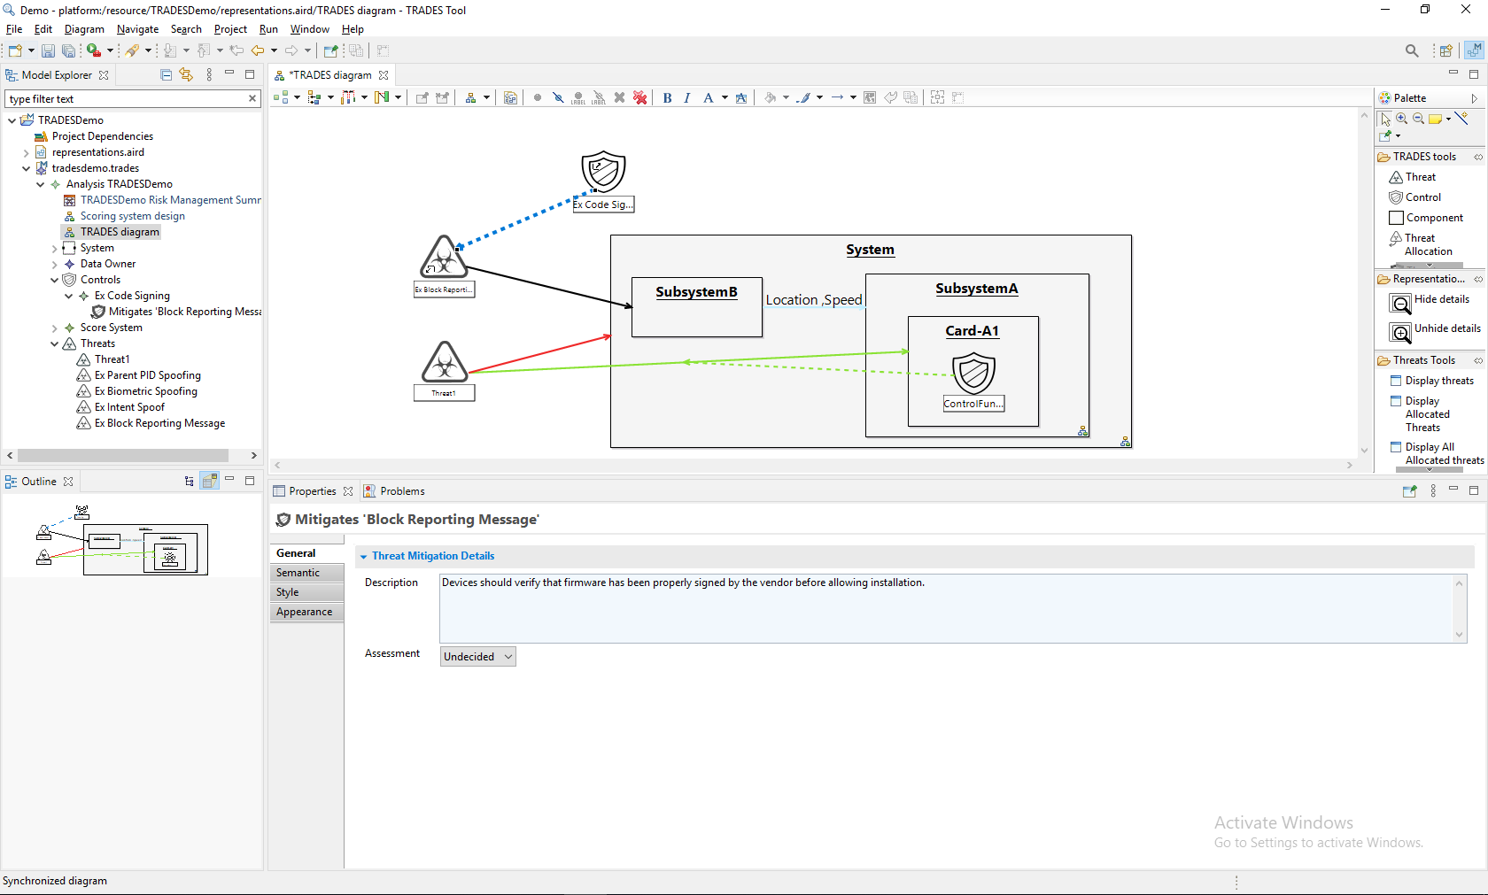
The threat was added
It is part of the model
All the relevant data is here

Slide 42
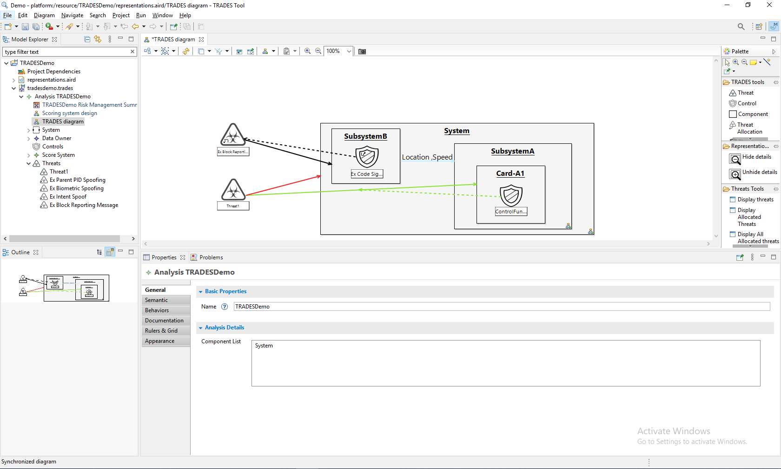
The control can be moved to the relevant component

Slide 43
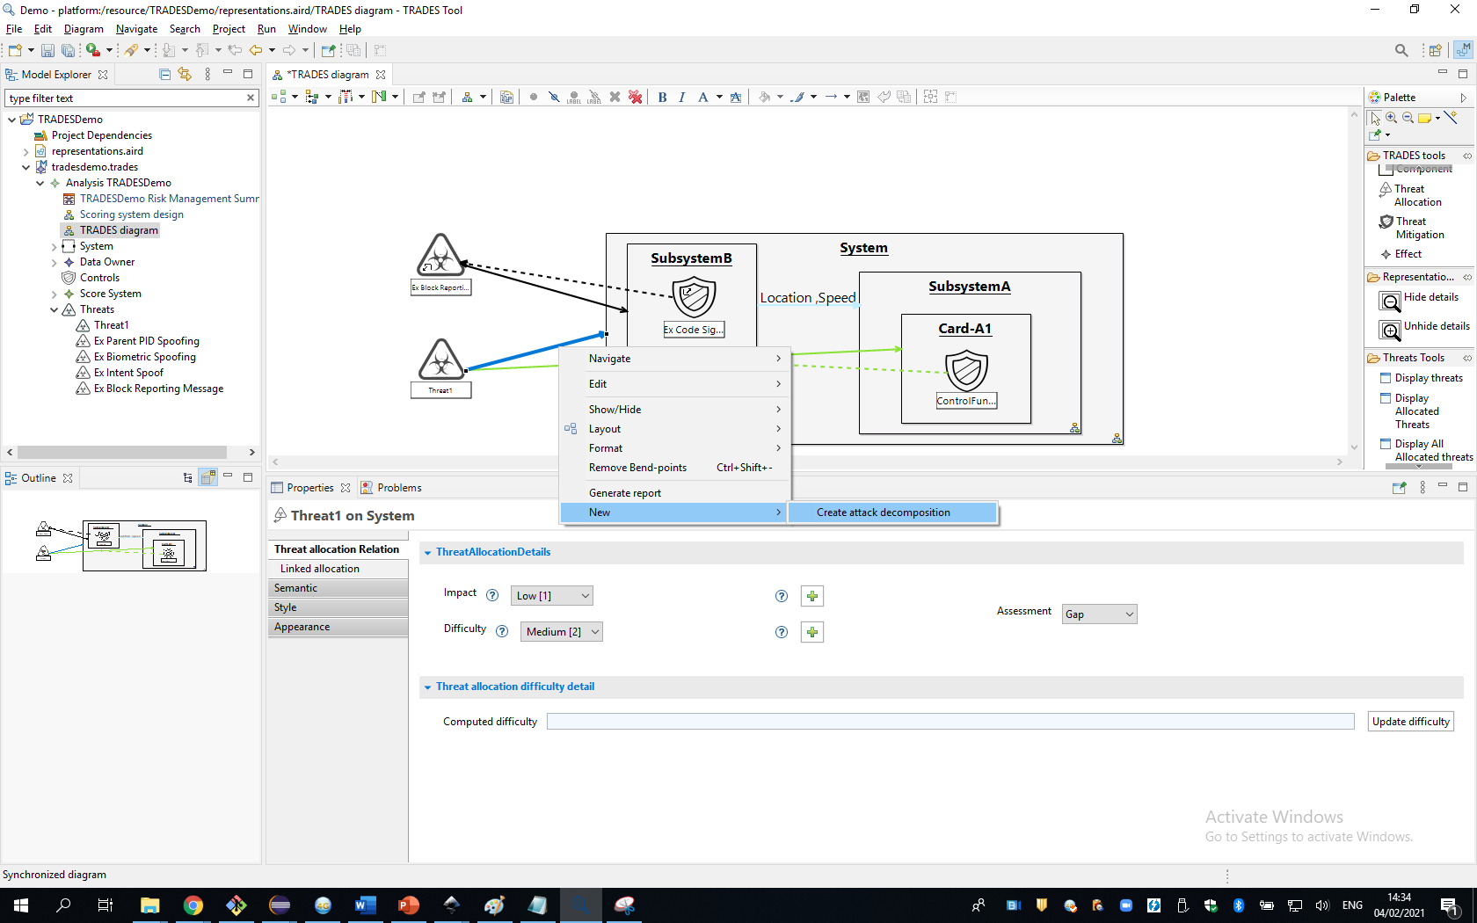
Threat allocations can be decomposed as an attack chain

Slide 44
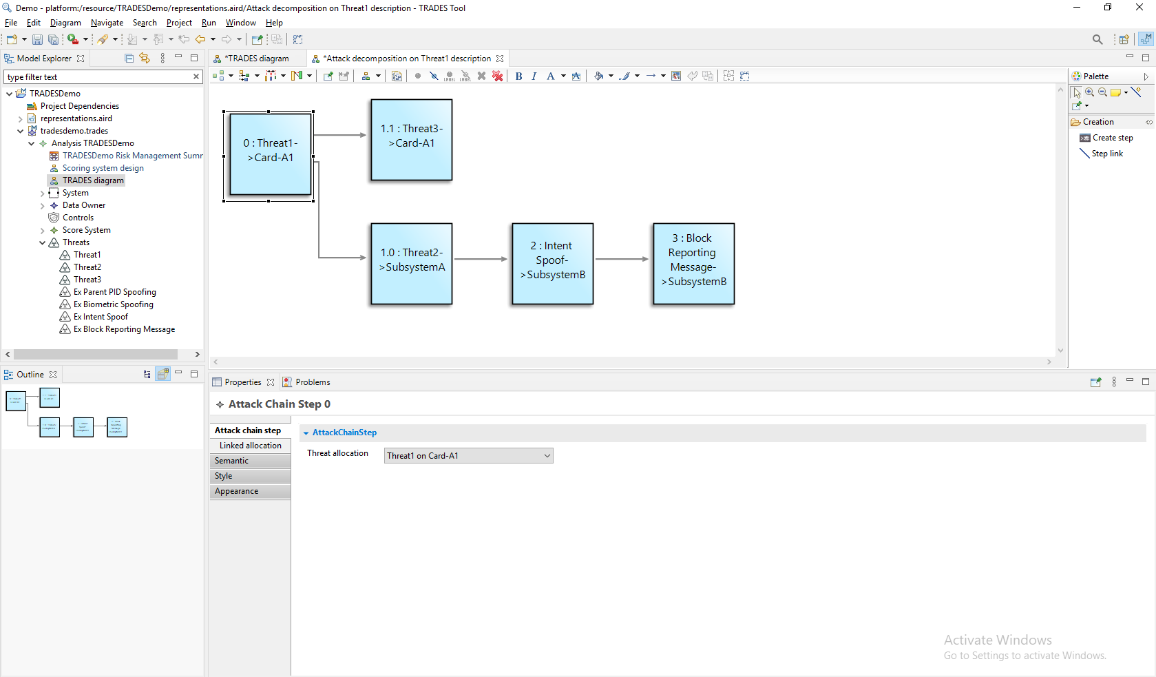
Each step related to threat allocation

Slide 45
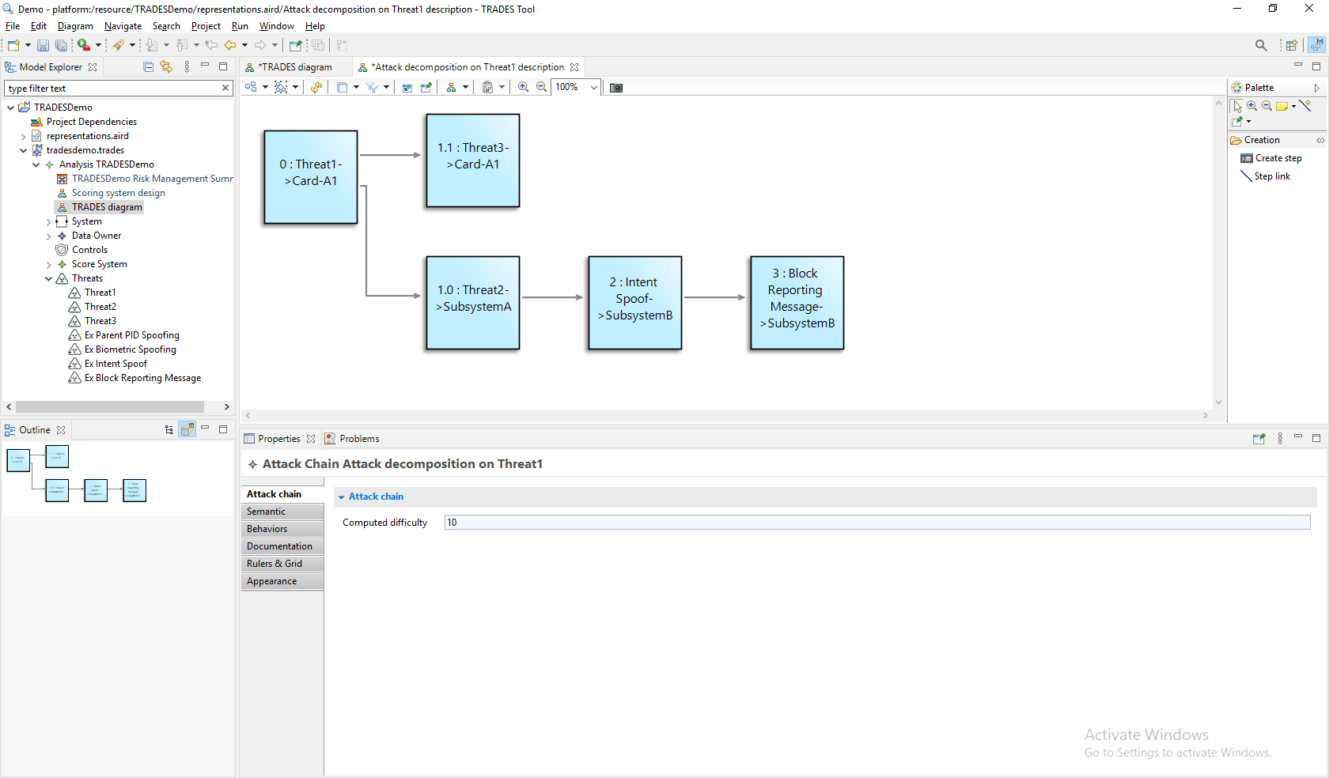
Suggest computed difficulty for the maim threat allocation

Slide 46
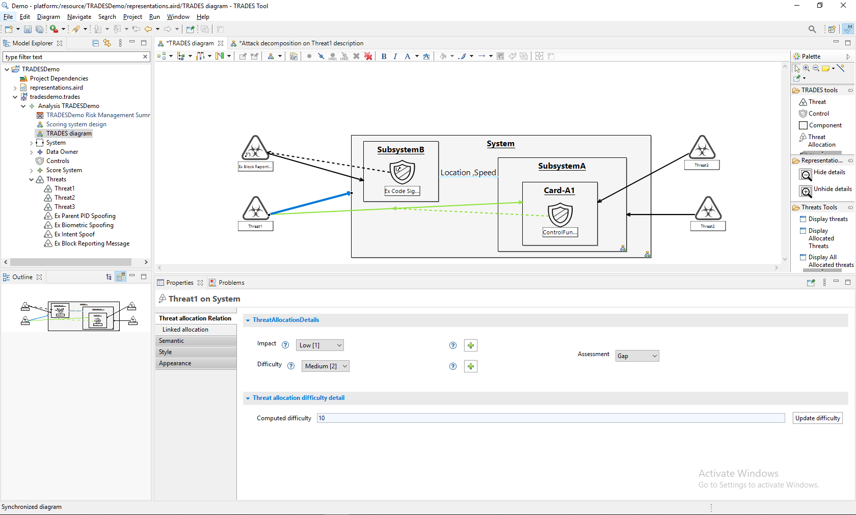
Synchronized with the maim diagram
Can be adopt

Slide 47
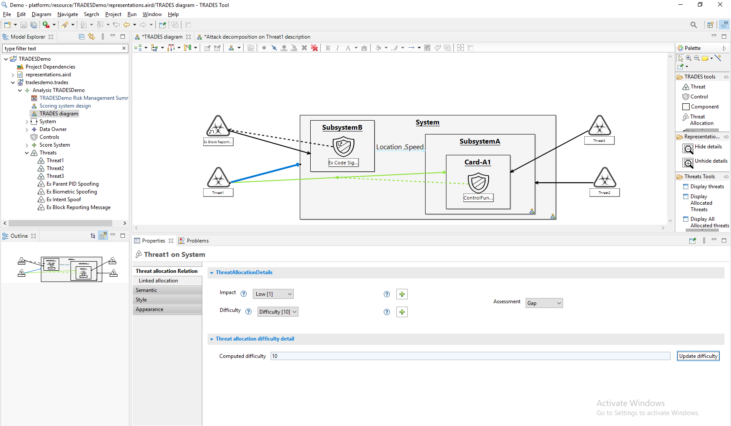
Calculated difficulty

Slide 48
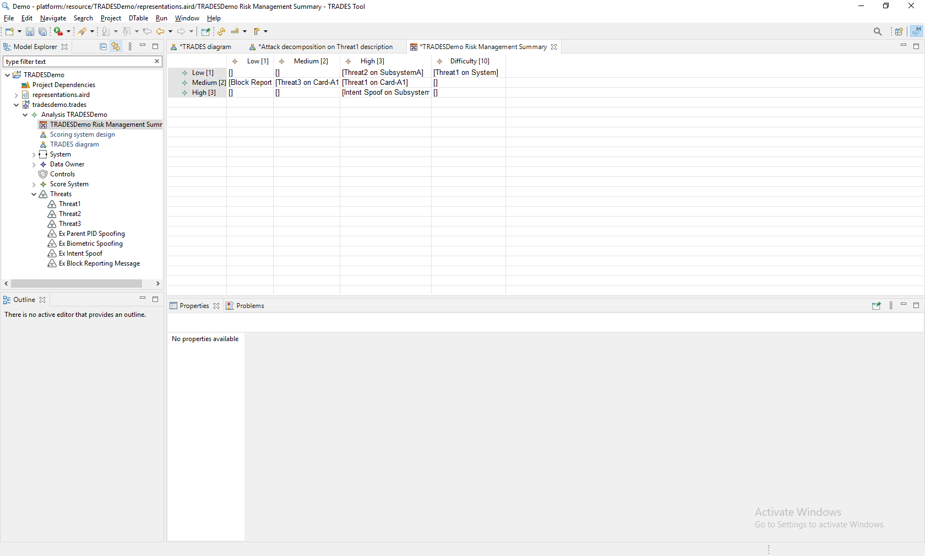
Risk management summary updated with the new difficulty

Slide 49
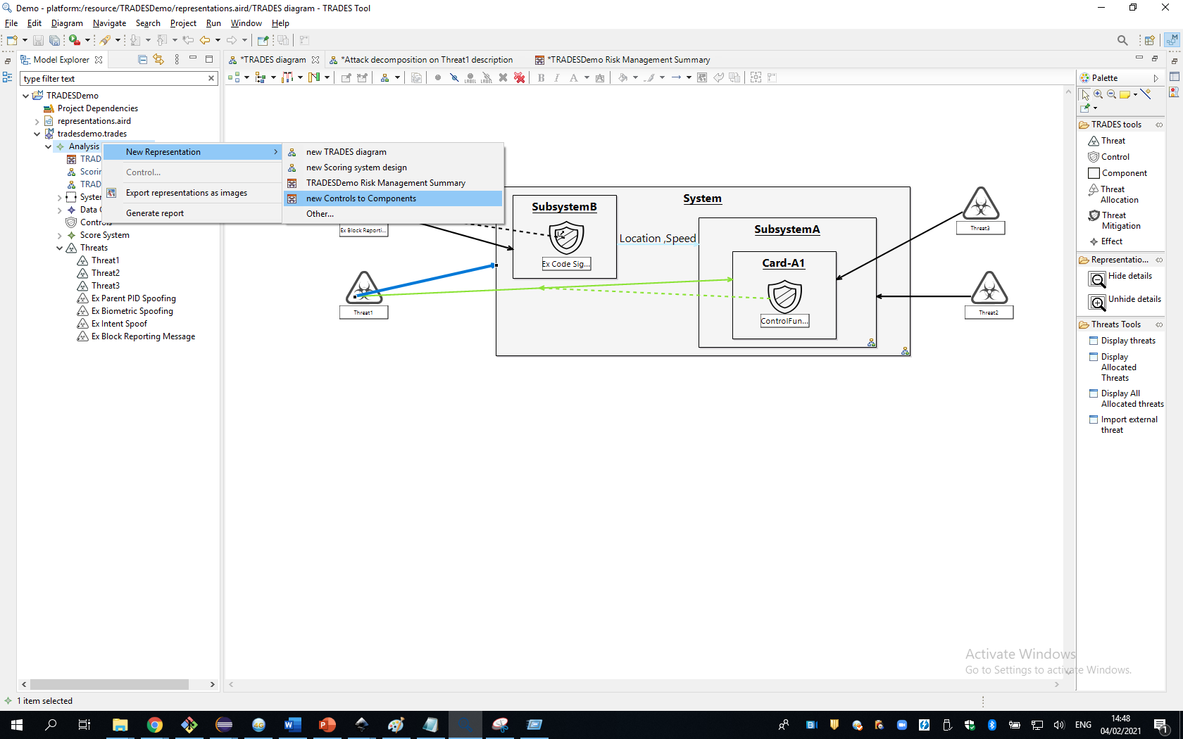
Controls to components tracking

Slide 50
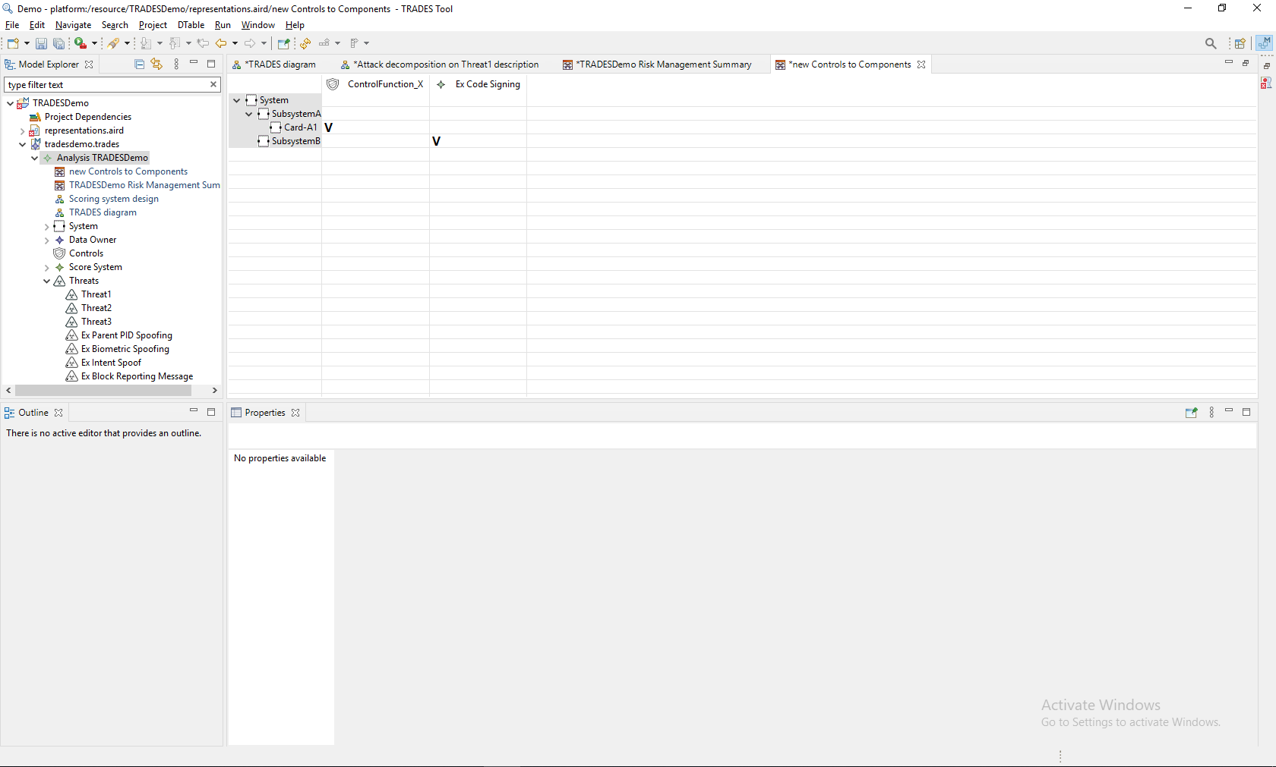
Helps you to understand the details

Slide 51
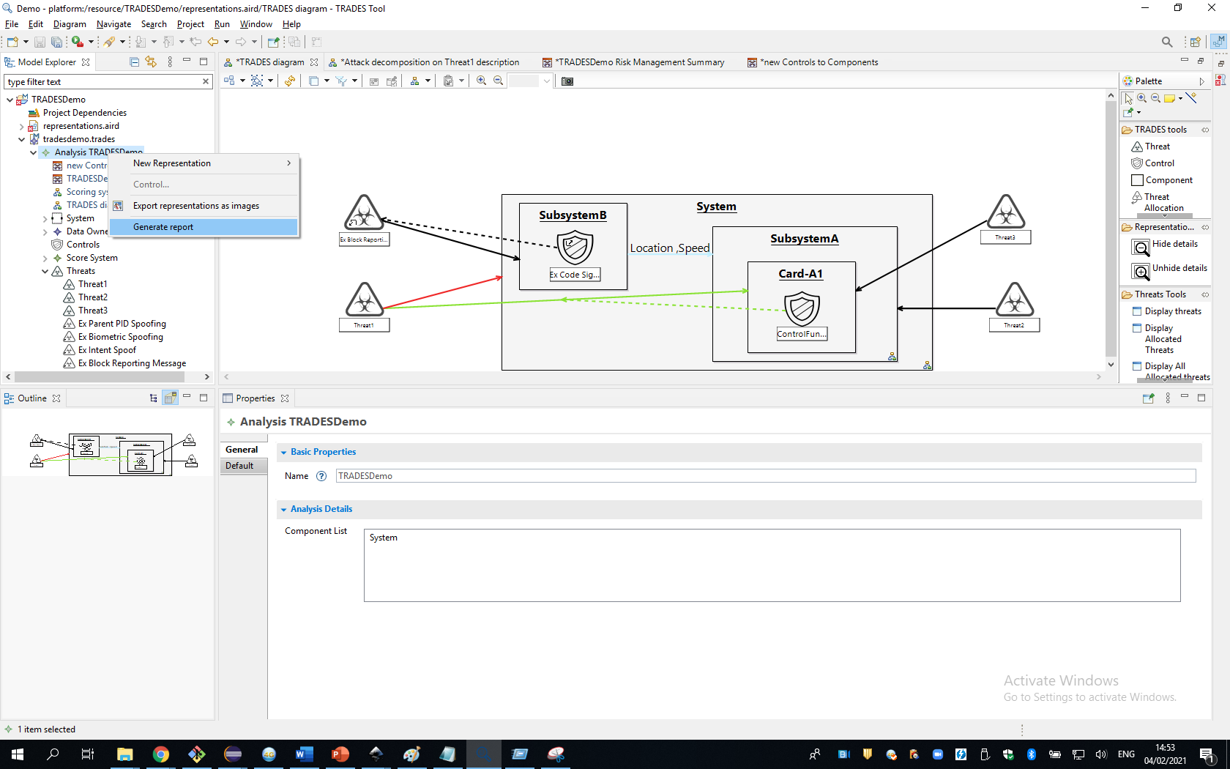
Word report can be generated with all the relevant data

Slide 52
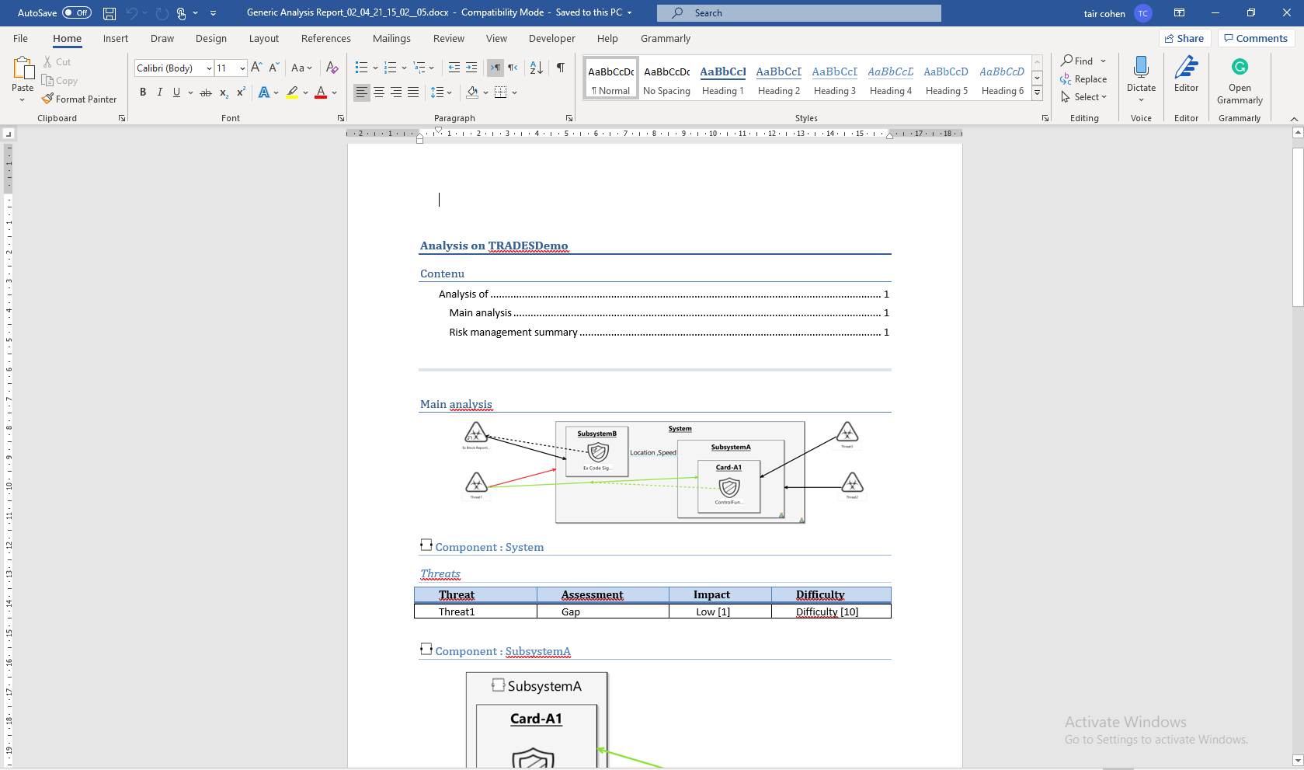

Slide 53
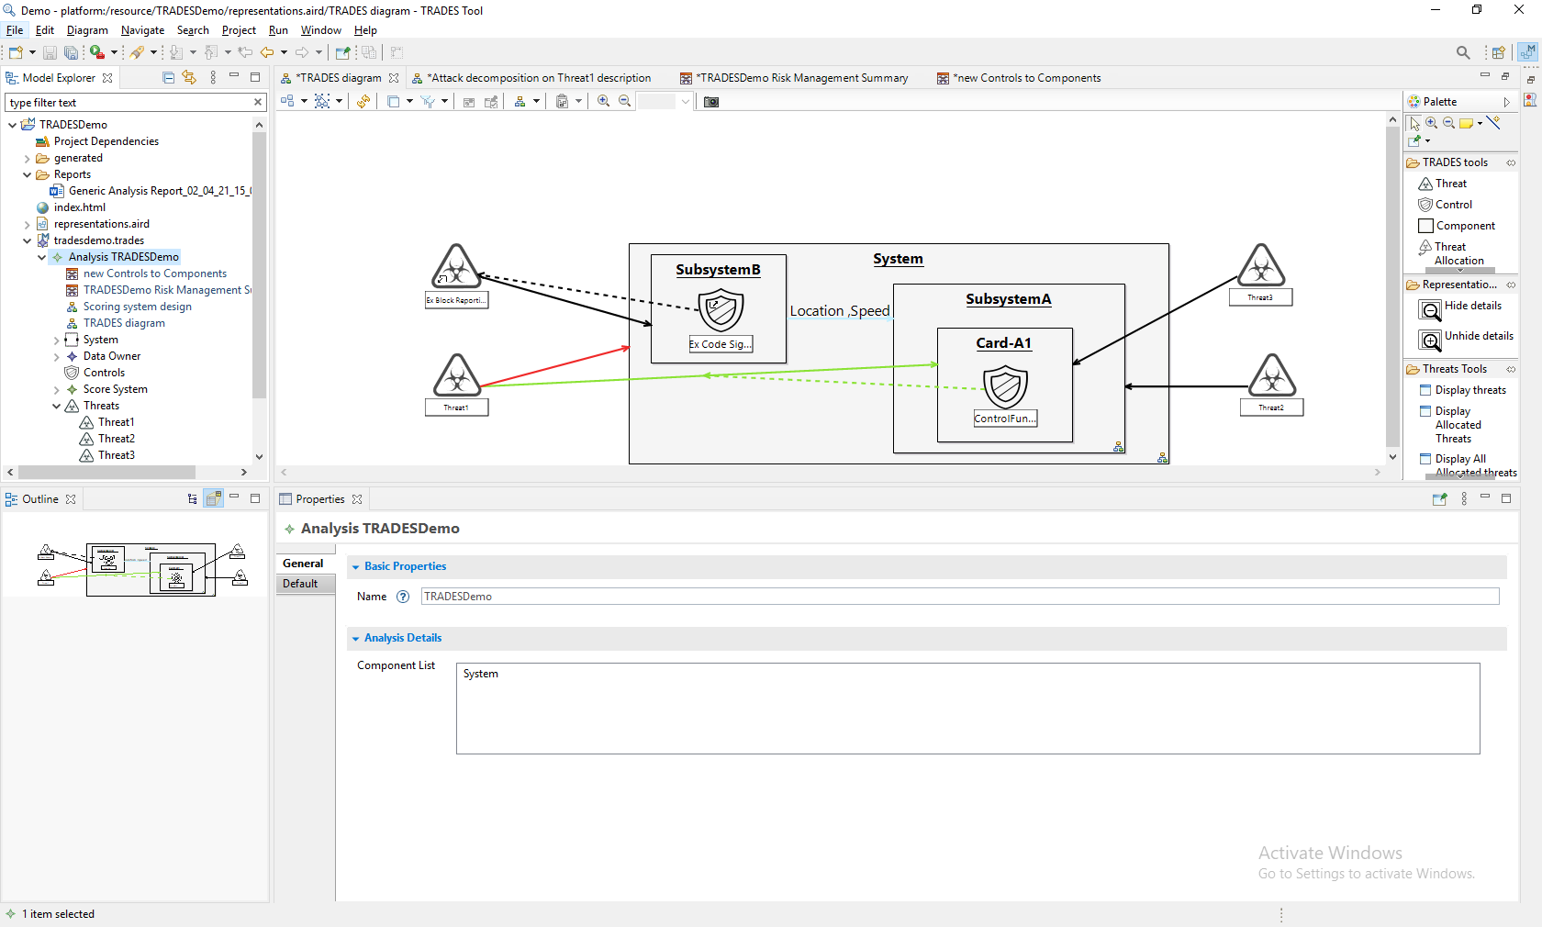
Saved here and can save several versions

Slide 54
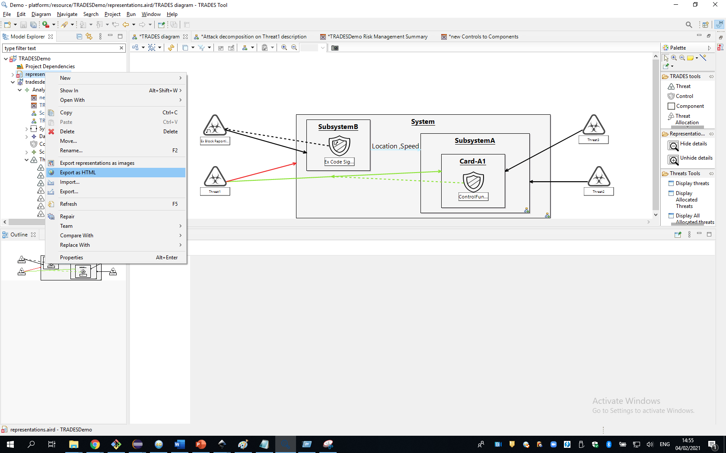
HTML report available

Slide 55

The model tree
Diagram
Entity's details

Slide 56
Summary
Elta’s Cyber Division developed a state of the art methodology and tool for cybersecurity related Threat and Risk assessment
TRADES model-based approach enables design of complex systems in a coordinated and documented manner
TRADES domain specific modeling approach facilitates easy and efficient adoption
TRADES supports establishing and maintaining cybersecurity aspects of the design throughout the development and operational product lifecycle

